Slide 1





Engineers are the physicians of the future!
Stephanie Taylor, MD, M Arch

Slide 2
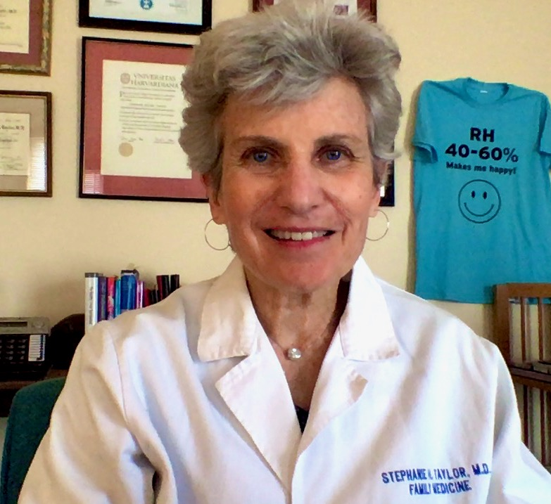
Hello! I am happy to be here with you today
Stephanie Taylor, MD, M Arch
Harvard Medical School
InCite Health Fellow
ASHRAE Distinguished Lecturer
Epidemic Task Force
Environmental Health Committee
President and Founder
Building 4 Health

Slide 3
Presentation Summary
My journey to you
Bridging divides
Homo Indooris
Studies on indoor humans and microbes
COVID and Beyond
Work like you will save the world, because you can

Slide 4
Presentation Summary
My journey to you
Bridging divides
Homo Indooris
Studies on indoor humans and microbes
COVID and Beyond
Work like you will save the world, because you can

Slide 5


My path to you started around 1983

Slide 6
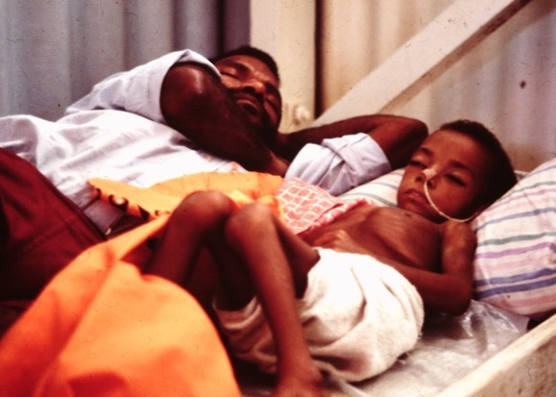
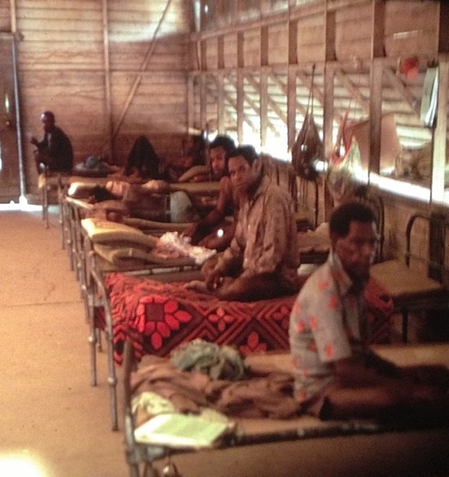
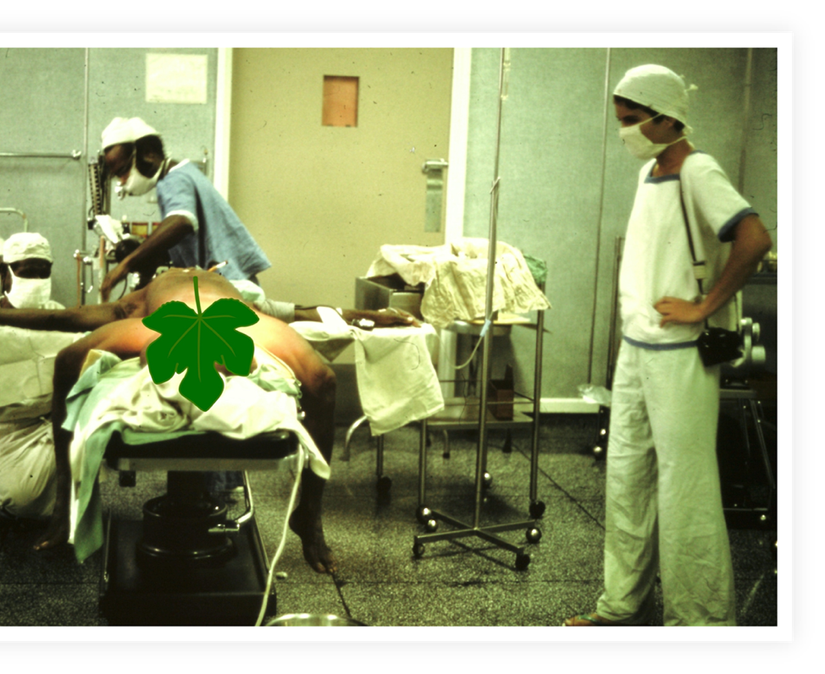
Non-hygienic hospital conditions, yet few infections
Wewack General Hospital, Papua New Guinea 1983

Slide 7

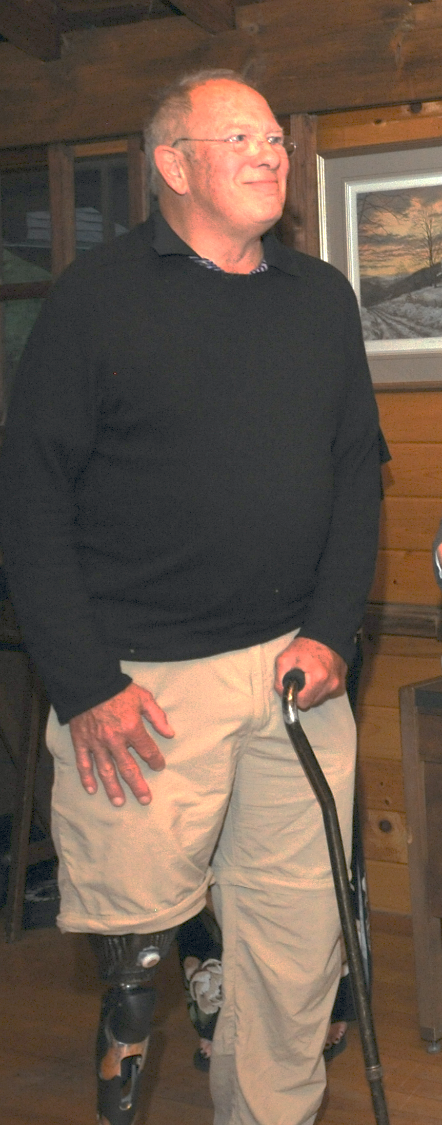
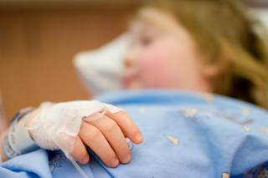
Yet, in N. America 1,700,000 patients/year get an infection from their hospitalization (HAI)
ADVERSE EVENTS = 393
Notes:
Classen, 2011‘Global Trigger Tool’ Shows
That Adverse Measured Events In Hospitals May Be Ten Times Greater
Than Previously

Slide 8
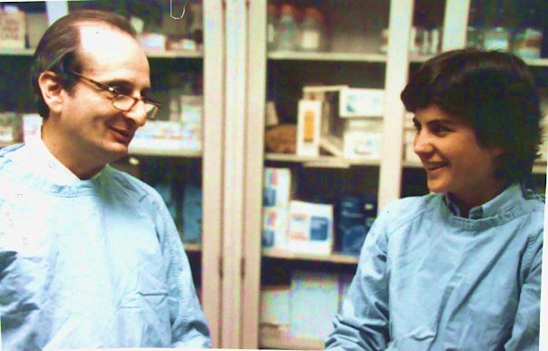
“Never underestimate the power of the environment!”
Harvard Medical School Chief-of-Surgery, Judah Folkman, M.D.
working with medical student, S. Taylor, 1986

Slide 9

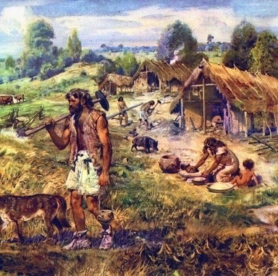




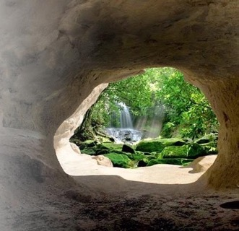

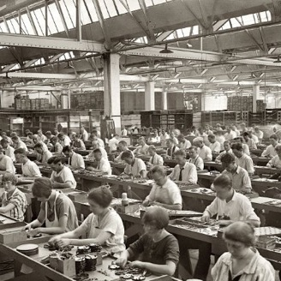




Our environment (90% indoors) has become very sophisticated
timeline: | 10,000 BC |  | 800 BC - 500 AC | 1900 AC | 2020
housing: | primitive housing, no sanitation systems |  | simple sanitation, in rural villages | industrial revolution: central sewage & water systems, heating, electricity | post-industrial cities, tighter buildings, dryer and warmer indoor air
infectious diseases: | parasites, zoonosis | 1st epidemics: small pox, measles, influenza, plague | 1st epidemics: small pox, measles, influenza, plague | 1st pandemic “Spanish flu” introduction of antibiotics & vaccines | Increasing infections, zoonotic transmis.,ABX-resistant bacteria
Notes:
Over more than350’000 year humans evolved parallel to the microbiome of outside world.
In the last 200 to 300 years housing, lifestyle, population density and mobility have changed dramatically!
Microbes easily evolve with these changes, having a much greater adaptive capacity than human physiology.

Slide 10


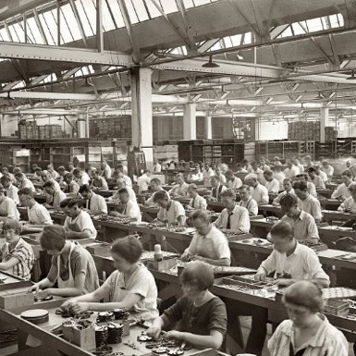



However, many diseases have increased
timeline: | 10,000 BC |  | 800 BC - 500 AC | 1900 AC | 2020
housing: | primitive housing, no sanitation systems |  | simple sanitation, in rural villages | industrial revolution: central sewage & water systems, heating, electricity | post-industrial cities, tighter buildings, dryer and warmer indoor air
infectious diseases: | parasites, zoonosis | 1st epidemics: small pox, measles, influenza, plague | 1st epidemics: small pox, measles, influenza, plague | 1st pandemic “Spanish flu” introduction of antibiotics & vaccines | Increasing infections, ABX-resistant bacteria, COVID-19
Infectious diseases
Notes:
Over more than350’000 year humans evolved parallel to the microbiome of outside world.
In the last 200 to 300 years housing, lifestyle, population density and mobility have changed dramatically!
Microbes easily evolve with these changes, having a much greater adaptive capacity than human physiology.

Slide 11
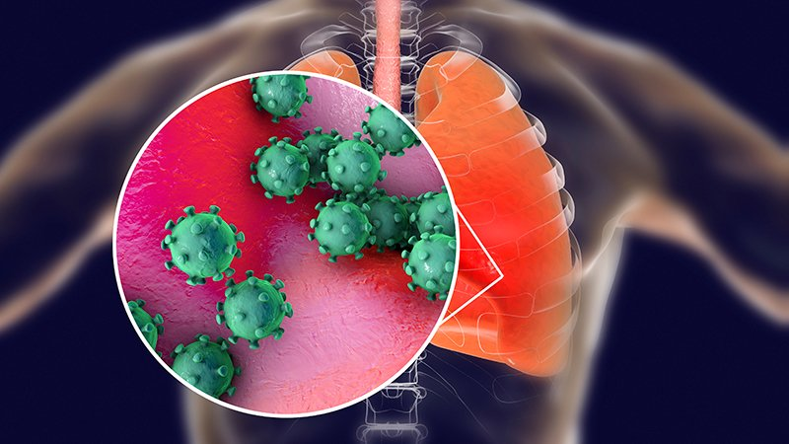
Now we have COVID-19 virus, a new Coronavirus mutation

Slide 12
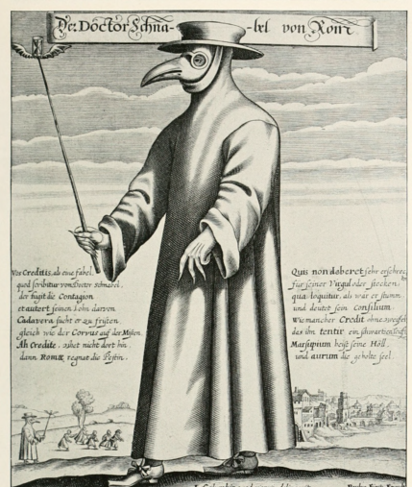
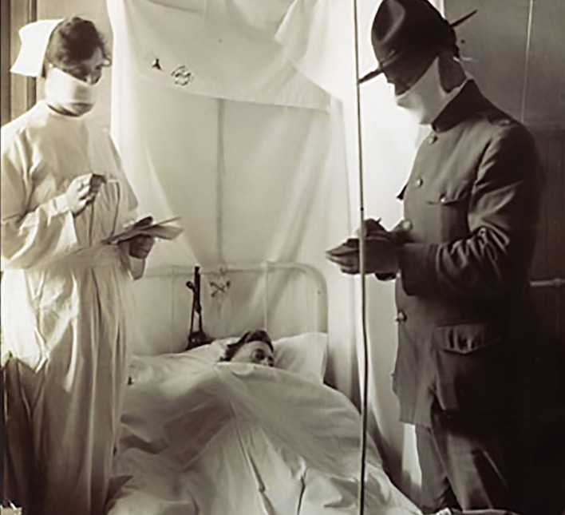
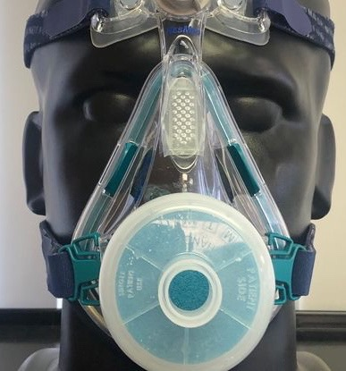
What have previous pandemics taught us?
Bubonic plague
1347
Spanish Influenza
1918
COVID-19
2020

Slide 13
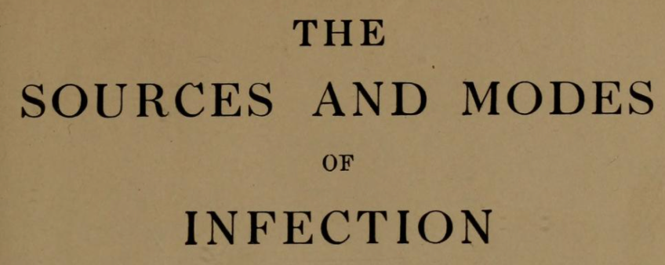
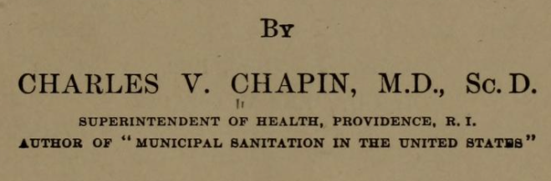

Yet, airborne transmission has been forever down-played
An influential physician discounted airborne transmission of germs, and then the Spanish Influenza hit…..
”It is impossible to teach people to avoid contact infection while they are firmly convinced that the air is the chief vehicle of infection.
It will be a great relief to most persons to be freed from the specter of infected air.”

Slide 14
Presentation Summary
My journey to you
Bridging divides
Homo Indooris
Studies on indoor humans and microbes
COVID and Beyond
Work like you will save the world, because you can

Slide 15

What can you do to protect yourself?

Slide 16
There are 3 steps where you can reduce the spread of COVID-19 disease
Viral load from infected person
Virus Transmission
Vulnerability of secondary host
1.
2.
3.
Behaviors
Indoor environment
Health and immunity

Slide 17
Reduce the load of infectious viruses
Viral load from infected person
Virus Transmission
Vulnerability of secondary host
1.
2.
3.
Indoor environment
Health and immunity
Behaviors

Slide 18
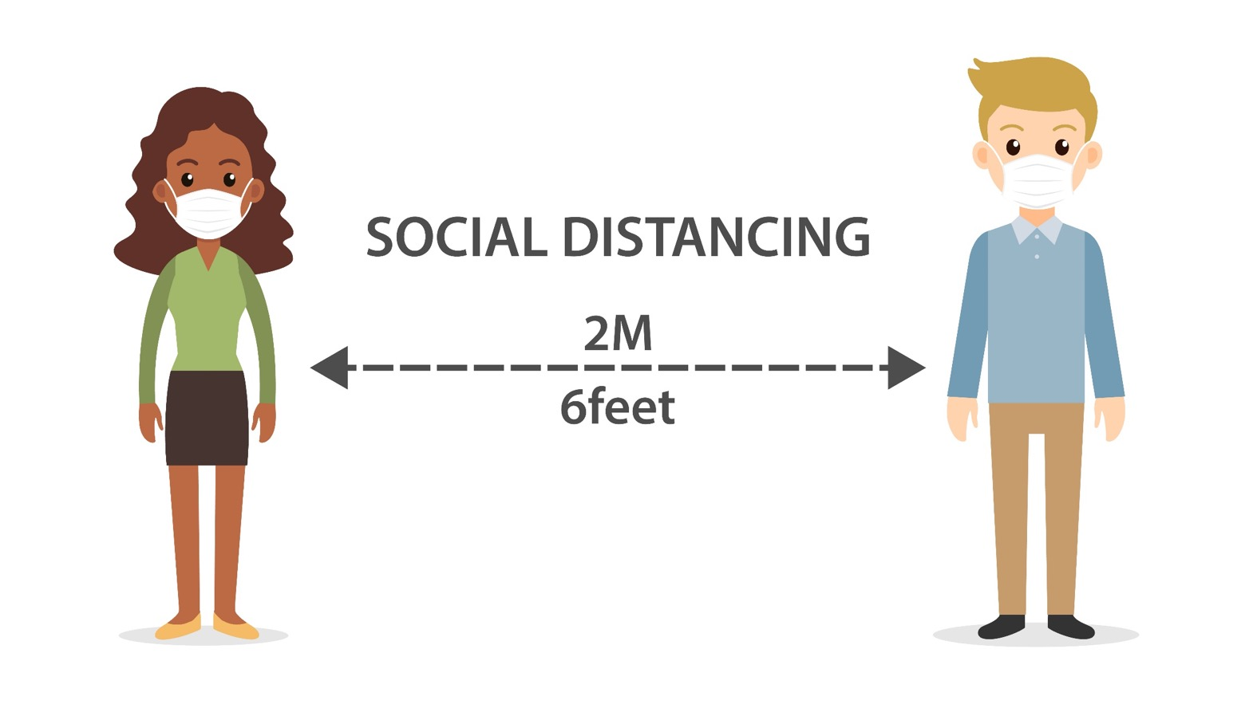
Social distancing, hand hygiene, face masks

Slide 19

Guidance on this has been a bit confusing!

Slide 20
Manage your building properly
Viral load from infected person
Virus Transmission
Vulnerability of secondary host
1.
2.
3.
Indoor environment
Health and immunity
Behaviors

Slide 21

Even Dr. Fauci was surprised by the power of indoor air management
Conference with Harvard hospitals

Slide 22

Are we managing our indoor air correctly?

Slide 23
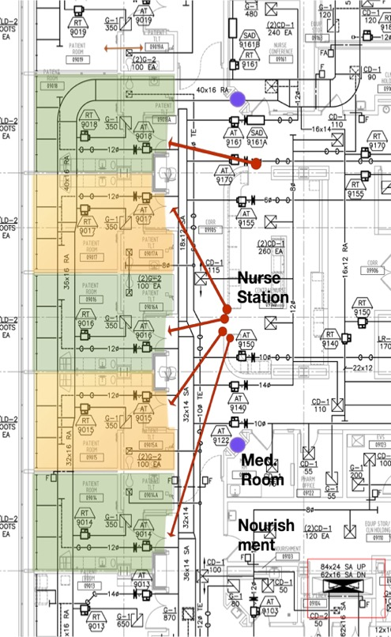

Indoor factors contribute to infections
Study design
Compared patient room data to hospital associated infections to determine key drivers
Temperature
Staff & visitor hand cleaning
Room pressurization
Lux
CO₂ level
Absolute humidity
Relative humidity
Room traffic
Room air changes
Outdoor air fractions
Academic hospital: 10 rooms, 13 months, 8M datapoints
Notes:
Built 2013, LEED Silver
1.2 million square feet
100,000 square feet per floor
240 single-occupancy inpatient rooms
52 ICU beds
28 ORs
Levels 8, 9, 10 - surgical, oncology and transplant patient rooms
Green roof
8 million data points on patient room environment!!
292 patients

Slide 24
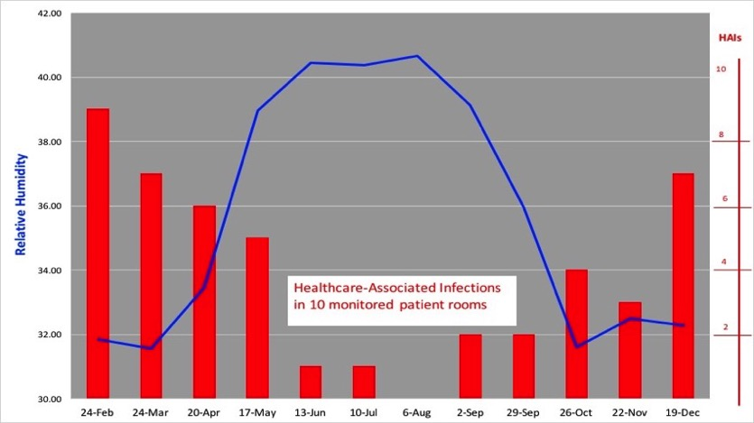
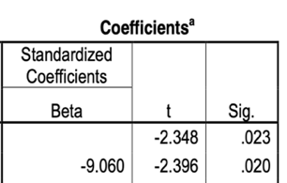
As patient room RH went down, infections went up!
Average RH for all patient rooms

Slide 25
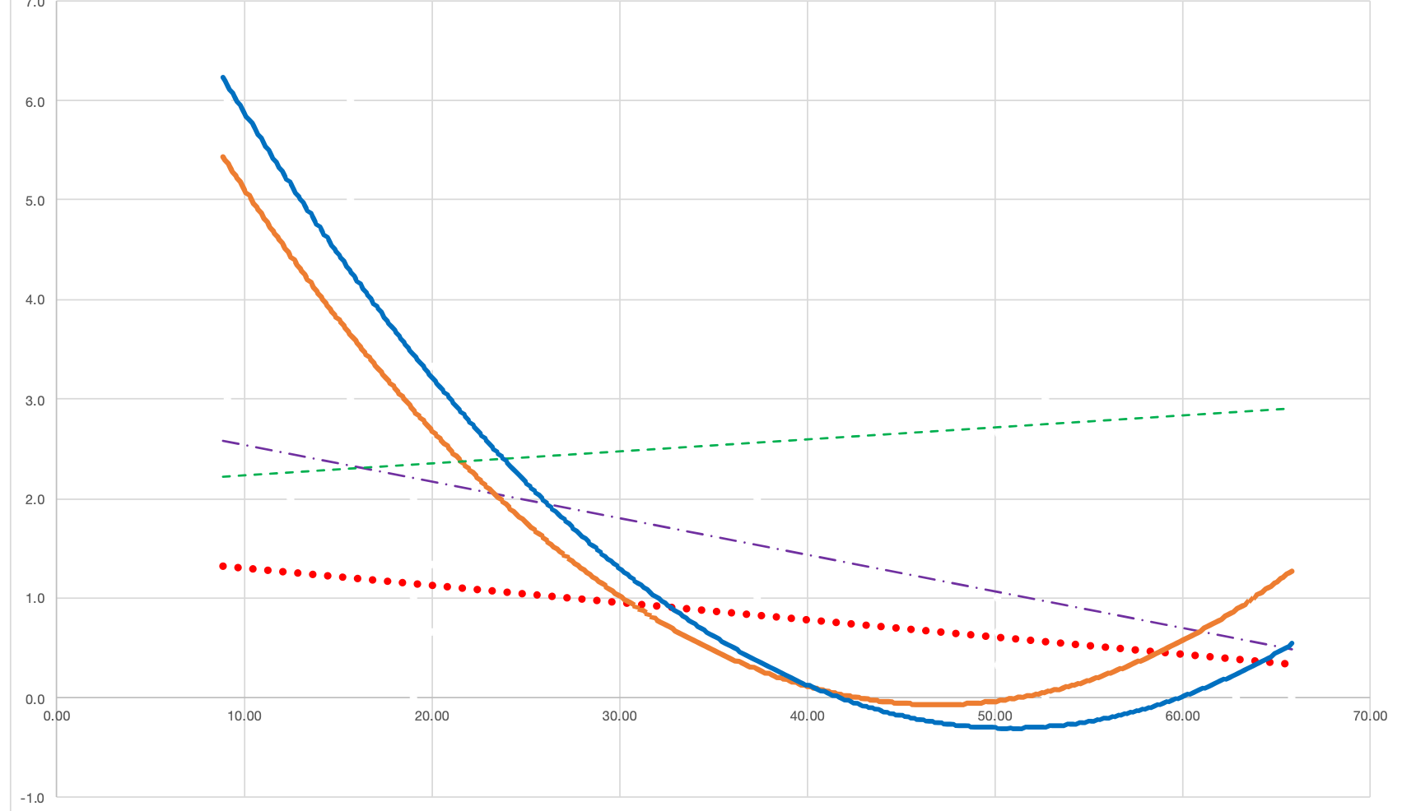
Nursing home study: Infection rates were lowest when indoor RH = 40-60%
Respiratory
(bacterial & viral)
Gastrointestinal
(Noro-virus, C diff)
Urinary tract infections
Cellulitis
Eye infections
avg # of infections
Indoor RH
40 %
60 %

Slide 26


Humidification decreased Influenza A illness in a pre-school
January 25 – March 11 (32 days)
Half of the classrooms were humidified, the other half were not
RH of classrooms | % Airborne particles carrying virus (PCR) | Virulence of airborne virus | # children absent due to influenza illness
20% | 49% | 75% | 22
45% | 19% | 35% | 9
Notes:
Reiman JM, Das B, Sindberg GM, Urban MD, Hammerlund MEM, Lee HB, et al. (2018) Humidity as a non-pharmaceutical intervention for influenza A. PLoS ONE 13(9): e0204337. https:// doi.org/10.1371/journal.pone.0204337

Slide 27
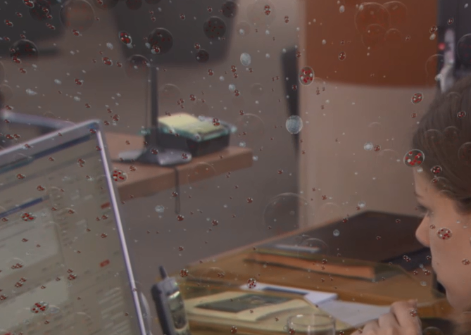
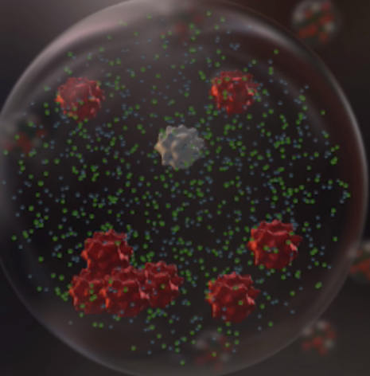
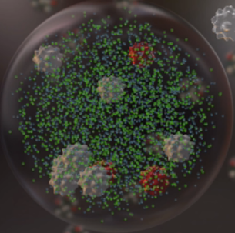
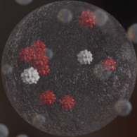
100 µm
50 µm
3.9 µm
100 % humidity
humidity over 45 %
humidity below 45 %
aerosol after exhalation
pathogens in droplet salt solution
salts crystallized
pathogens can remain active

Slide 28
At all temperatures inactivation of SARS Coronavirus was fastest in intermediate RH
100
10
1
0.1
0.01
blue line = 20°C
black line =
red line = 40°C
At all temperatures the inactivation rate is fastest in intermediate humidity of 50% RH
4°C
viable viruses [%]
longstanding
viability
fast
inactivation
longstanding
viability
0% 20% 40% 50% 60% 80% 100% RH
Notes:
Casanova LM et al, Effects of Air Temperature and Relative Humidity on Coronavirus Survival on Surfaces, APPLIED AND ENVIRONMENTAL
MICROBIOLOGY, May 2010, p. 2712–2717

Slide 29
Humidification to 50% RH reduces the viable Coronavirus to less than 1% in 2 days, significantly decreasing the infection risk (blue line).
100
10
1
0.1
0.01
RH 20% , T 20°C
inactivation log₁₀ - 0.081/day
viable viruses [%]
RH 80% , T 20°C
inactivation log₁₀ - 0.212/day
RH 50% , T 20°C
inactivation log₁₀ - 0.896/day
1 2 3 4 5 6 7 8 9 10 11 12 13 14 days
Notes:
Casanova LM et al, Effects of Air Temperature and Relative Humidity on Coronavirus Survival on Surfaces, APPLIED AND ENVIRONMENTAL
MICROBIOLOGY, May 2010, p. 2712–2717

Slide 30
Stay strong and healthy
Viral load from infected person
Virus Transmission
Vulnerability of secondary host
1.
2.
3.
Indoor environment
Health and immunity
Behaviors

Slide 31
2019 A key study published in PNAS
“Low ambient humidity impairs barrier function and
innate resistance against influenza infection”
Eriko Kudo, Eric Song, Laura Yockey, Tasfia Rakib, Patrick Wong, Robert Homer, Akiko Iwasaki
Proceedings of the National Academy of Sciences, USA. May 19, 2019
This study was done in genetically engineered mice

Slide 32
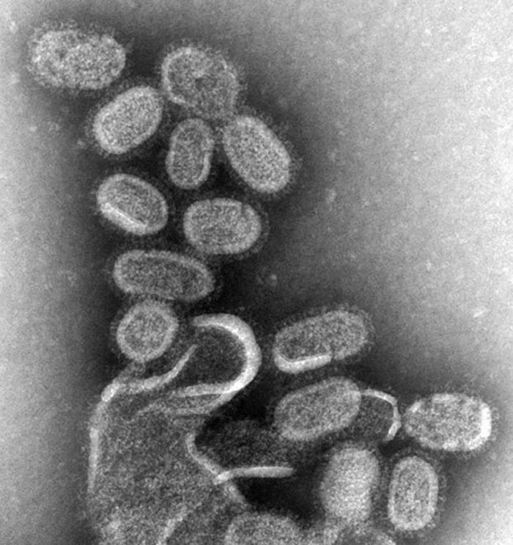
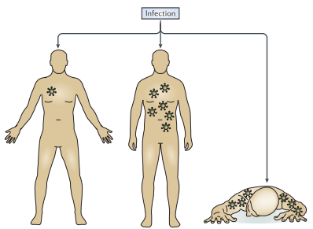
Why do we get worst flu illness in the winter?
RH 50%
RH 20%

Slide 33
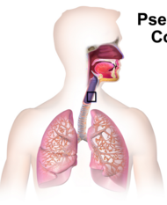

How does our body protect us from respiratory infections?
Influenza virus
Influenza virus is spread from infected people by coughs or sneezes.
Notes:
How do we remove influenza virus when we got flu? Influenza virus is spread from infected people by cough or sneeze. Influenza virus come in our body and reach upper trachea area.

Slide 34
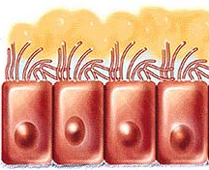
A healthy immune system provides protection
Proximal
Physical barrier: Mucus production and ciliary clearance
Distal
First line of defense against pathogens
Notes:
Primary innate defense is mucus production and ciliary clearance to remove virus and protect virus infection. This is first line of defense against pathogen.

Slide 35
A healthy immune system provides protection
Physical barrier: Mucus production and ciliary clearance
Innate immune responses: Type I IFN and Interferon stimulated genes (ISGs)
Interferon
Activate
T cell
B cell
Dendritic cell
Macrophage
Notes:
Next, when some virus infects epithelial cells, epithelial cells and other immune cells produce type I interform and interferon stimulated genes to eliminate virus and activate immune cells.

Slide 36
All of these protective mechanisms are impaired at RH 20% and are optimal at 50% RH
Improved muco-ciliary clearance
Enhanced protection induced by Interferon
Decreased inflammation and tissue damage
Enhanced tissue
repair

Slide 37

What bats can teach us about developing immunity to Covid-19
Viruses love bats!
Bats live in large communities
Their air travel provides a transmission route for viruses
Individual animals have long lives, enabling a virus to persist for years
We now know that this is due to high levels of interferon in bats!

Slide 38
Low RH suppressed interferon protection in both infected and uninfected cells
Antiviral effect through interferon
Mx1
50% humidity enhances antiviral response.
Notes:
Flu RNA positive or negative cells were higher expressed Mx1 RNA in 50% RH mice. These results suggest that IFN-induced Mx1expression is also more robust at the higher humidity.

Slide 39
Humidification supports two of these three catagories
Viral load from infected person
Virus Transmission
Vulnerability of secondary host
1.
2.
3.
Behaviors
Indoor environment
Health and immunity

Slide 40
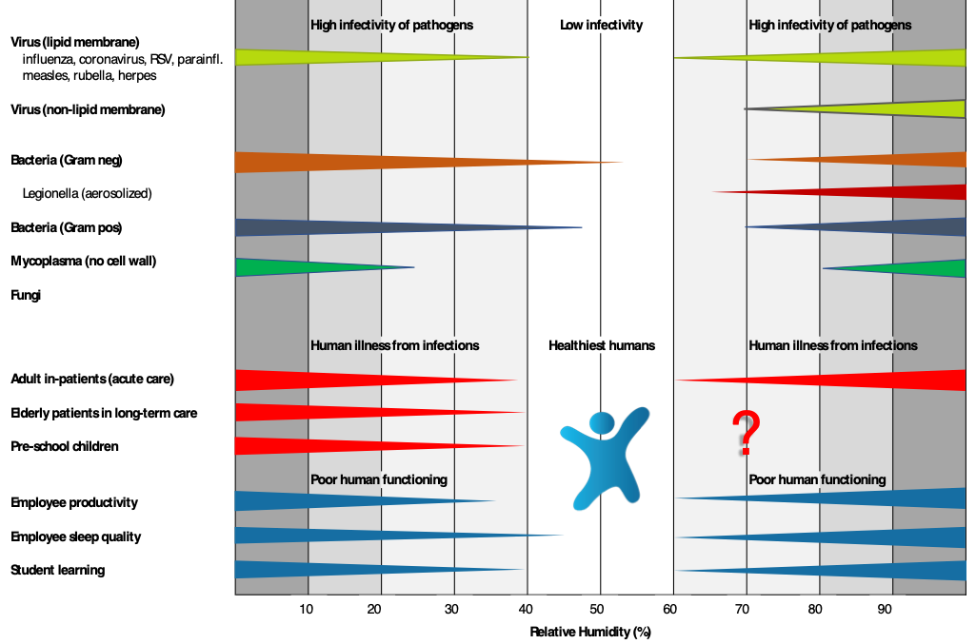
Taylor Chart 2019

Slide 41
Presentation Summary
My journey to you
Bridging divides
Homo Indooris
Studies on indoor humans and microbes
COVID and Beyond
Work like you will save the world, because you can

Slide 42

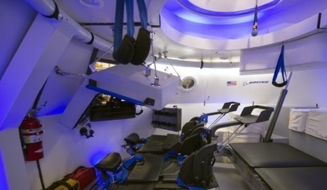

Humidification is used when the financial benefits are clear
National Institute of Health animal facility
NASA spacecraft
Louvre
Replacement cost of a primate: $22,000
Cost to train an astronaut: $50 million (in 2006)
Mona Lisa value: $780 million
RH 40%–60%
RH 40%–60%
RH 40%–60%

Slide 43


Do healthy humans have a dollar value?

Slide 44
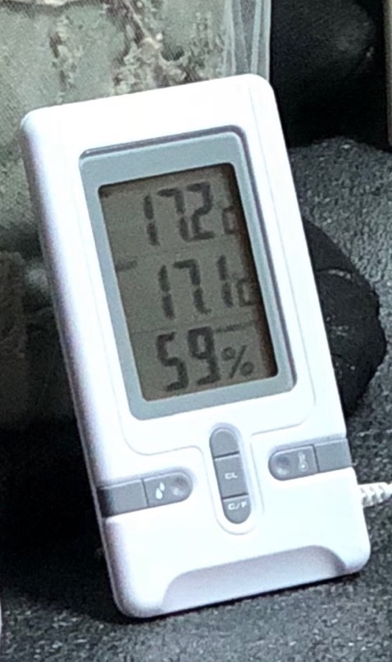
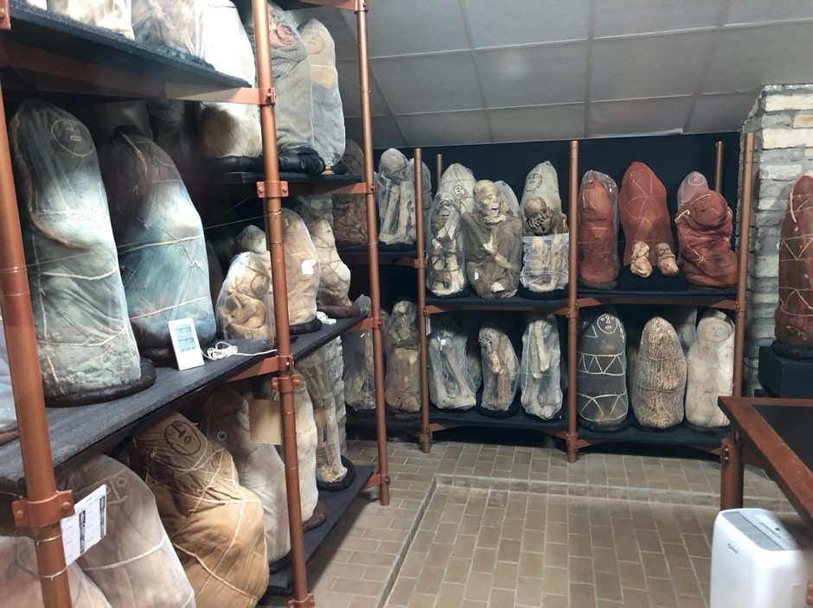
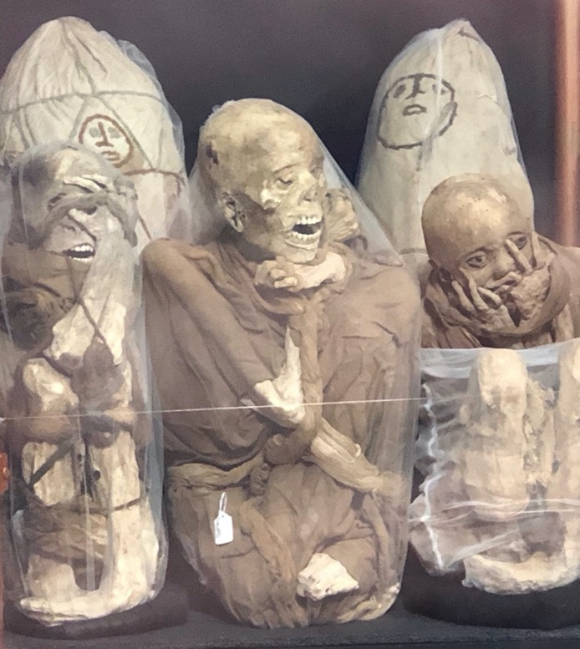
These humans are worthy of humidification
“Arrrgghh, Why didn’t we humidify our air sooner?!?”
,
Why did we wait

Slide 45
Strategies to decrease transmission of pathogens indoors
Midrange humidity control
Outdoor air ventilation
Sunlight
UVC
Bipolar ionization
Use of hydrogen peroxide
Filtration
Other
RH 40-60 % enhances many of these strategies!
Notes:
Figure 1. Representative spectra for simulated sunlight. Simulated sunlight spectra utilized in the present study (black lines), spectra from the National Center for Atmospheric Research (NCAR) tropospheric ultraviolet and visible (TUV) radiation model for noon at 40°N latitude at sea level (gray lines), and spectra measured for darkness (blue lines) are shown (for color figure refer online version). A, Spectra for high-intensity simulated sunlight and TUV model for 21 June. B, Spectra for midintensity simulated sunlight and TUV model for both 7 March and 4 October. C, Spectra for high-intensity simulated sunlight and TUV model for 21 June, with irradiance plotted logarithmically. D, Spectra for midintensity simulated sunlight and TUV model for both 7 March and 4 October, with irradiance plotted logarithmically. Integrated irradiances for the UVA and UVB portions of the spectra for both the measured and TUV model spectra demonstrate close agreement between the measured and model values. For high-intensity simulated sunlight, measured integrated UVB irradiance was 1.91 W/m2 vs 1.84 W/m2 predicted by TUV for 21 June. Measured integrated UVA irradiance was 69.76 W/m2 vs 58.50 W/m2 predicted by TUV for 21 June. For midintensity simulated sunlight, measured integrated UVB irradiance was 0.94 W/m2 vs 0.92 W/m2 predicted by TUV for 7 March and 4 October. Measured integrated UVA irradiance was 31.97 W/m2 vs 40.54 and 40.25 W/m2 predicted by TUV for 7 March and 4 October, respectively. No irradiance was detectable above the background of the spectroradiometer measured in darkness for wavelengths less than approximately 295 nm. Vertical dashed lines represent the cutoffs between UVC and UVB (280 nm), and UVB and UVA (315 nm).
Unless provided in the caption above, the following copyright applies to the content of this slide: © The Author(s) 2020. Published by Oxford University Press for the Infectious Diseases Society of America.This is an Open Access article distributed under the terms of the Creative Commons Attribution-NonCommercial-NoDerivs licence (http://creativecommons.org/licenses/by-nc-nd/4.0/), which permits non-commercial reproduction and distribution of the work, in any medium, provided the original work is not altered or transformed in any way, and that the work is properly cited. For commercial re-use, please contact journals.permissions@oup.com

Slide 46

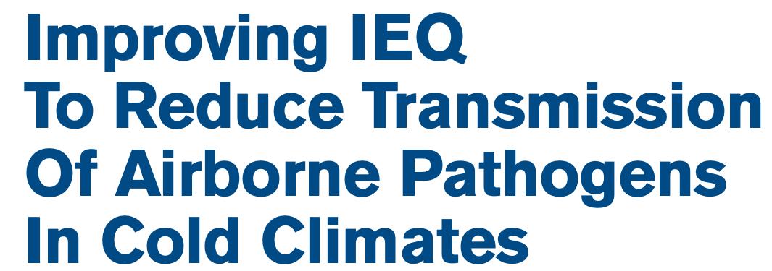
Hot off the press: ASHRAE Journal, September 2020
Stephanie Taylor, MD, Michael Scofield, ASHRAE Fellow, Patricia Graef, PE, ASHRAE Fellow

Slide 47
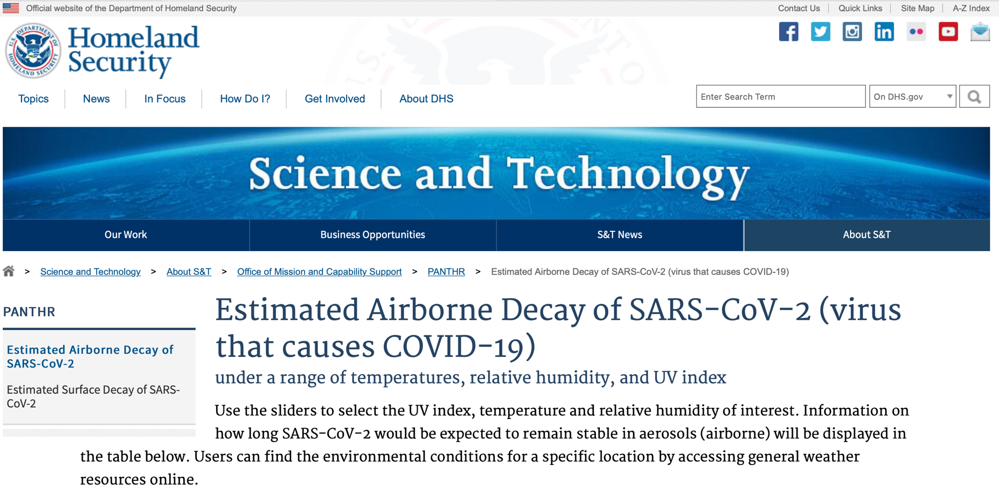

Homeland study using simulated sunlight
Notes:
Figure 1. Representative spectra for simulated sunlight. Simulated sunlight spectra utilized in the present study (black lines), spectra from the National Center for Atmospheric Research (NCAR) tropospheric ultraviolet and visible (TUV) radiation model for noon at 40°N latitude at sea level (gray lines), and spectra measured for darkness (blue lines) are shown (for color figure refer online version). A, Spectra for high-intensity simulated sunlight and TUV model for 21 June. B, Spectra for midintensity simulated sunlight and TUV model for both 7 March and 4 October. C, Spectra for high-intensity simulated sunlight and TUV model for 21 June, with irradiance plotted logarithmically. D, Spectra for midintensity simulated sunlight and TUV model for both 7 March and 4 October, with irradiance plotted logarithmically. Integrated irradiances for the UVA and UVB portions of the spectra for both the measured and TUV model spectra demonstrate close agreement between the measured and model values. For high-intensity simulated sunlight, measured integrated UVB irradiance was 1.91 W/m2 vs 1.84 W/m2 predicted by TUV for 21 June. Measured integrated UVA irradiance was 69.76 W/m2 vs 58.50 W/m2 predicted by TUV for 21 June. For midintensity simulated sunlight, measured integrated UVB irradiance was 0.94 W/m2 vs 0.92 W/m2 predicted by TUV for 7 March and 4 October. Measured integrated UVA irradiance was 31.97 W/m2 vs 40.54 and 40.25 W/m2 predicted by TUV for 7 March and 4 October, respectively. No irradiance was detectable above the background of the spectroradiometer measured in darkness for wavelengths less than approximately 295 nm. Vertical dashed lines represent the cutoffs between UVC and UVB (280 nm), and UVB and UVA (315 nm).
Unless provided in the caption above, the following copyright applies to the content of this slide: © The Author(s) 2020. Published by Oxford University Press for the Infectious Diseases Society of America.This is an Open Access article distributed under the terms of the Creative Commons Attribution-NonCommercial-NoDerivs licence (http://creativecommons.org/licenses/by-nc-nd/4.0/), which permits non-commercial reproduction and distribution of the work, in any medium, provided the original work is not altered or transformed in any way, and that the work is properly cited. For commercial re-use, please contact journals.permissions@oup.com

Slide 48
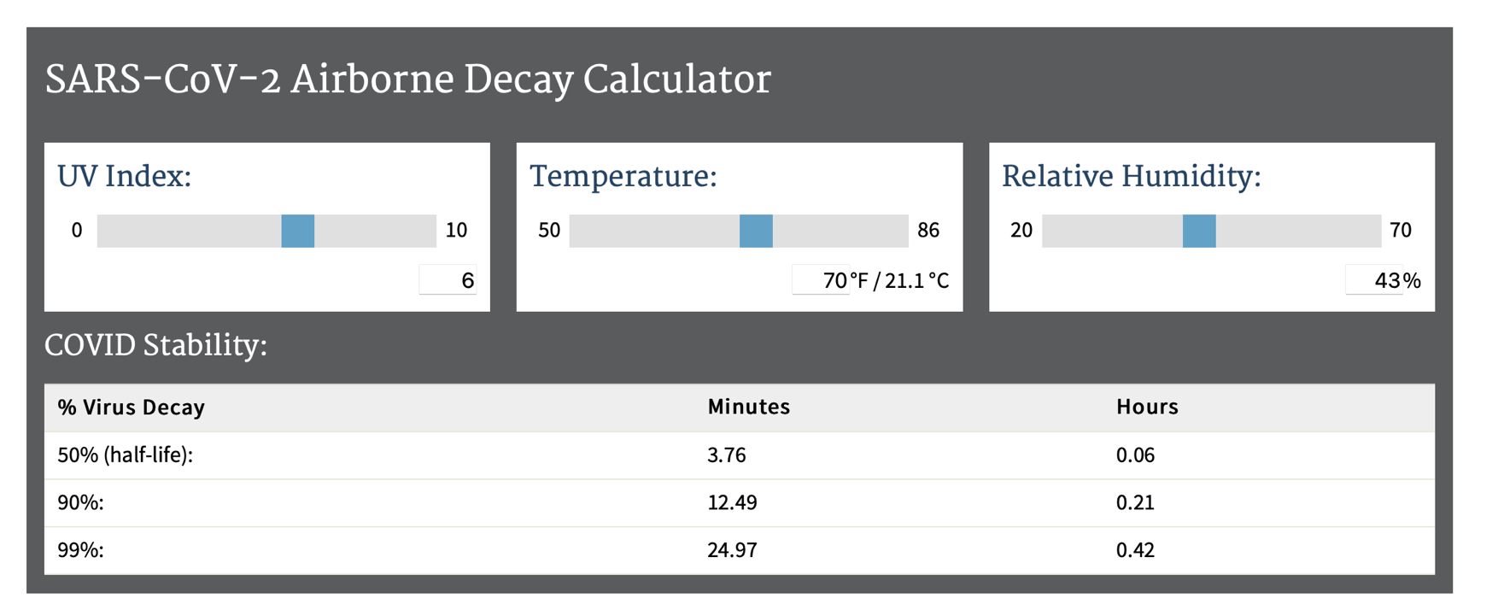
Simulated sunlight spectra utilized in the present study
Notes:
Figure 1. Representative spectra for simulated sunlight. Simulated sunlight spectra utilized in the present study (black lines), spectra from the National Center for Atmospheric Research (NCAR) tropospheric ultraviolet and visible (TUV) radiation model for noon at 40°N latitude at sea level (gray lines), and spectra measured for darkness (blue lines) are shown (for color figure refer online version). A, Spectra for high-intensity simulated sunlight and TUV model for 21 June. B, Spectra for midintensity simulated sunlight and TUV model for both 7 March and 4 October. C, Spectra for high-intensity simulated sunlight and TUV model for 21 June, with irradiance plotted logarithmically. D, Spectra for midintensity simulated sunlight and TUV model for both 7 March and 4 October, with irradiance plotted logarithmically. Integrated irradiances for the UVA and UVB portions of the spectra for both the measured and TUV model spectra demonstrate close agreement between the measured and model values. For high-intensity simulated sunlight, measured integrated UVB irradiance was 1.91 W/m2 vs 1.84 W/m2 predicted by TUV for 21 June. Measured integrated UVA irradiance was 69.76 W/m2 vs 58.50 W/m2 predicted by TUV for 21 June. For midintensity simulated sunlight, measured integrated UVB irradiance was 0.94 W/m2 vs 0.92 W/m2 predicted by TUV for 7 March and 4 October. Measured integrated UVA irradiance was 31.97 W/m2 vs 40.54 and 40.25 W/m2 predicted by TUV for 7 March and 4 October, respectively. No irradiance was detectable above the background of the spectroradiometer measured in darkness for wavelengths less than approximately 295 nm. Vertical dashed lines represent the cutoffs between UVC and UVB (280 nm), and UVB and UVA (315 nm).
Unless provided in the caption above, the following copyright applies to the content of this slide: © The Author(s) 2020. Published by Oxford University Press for the Infectious Diseases Society of America.This is an Open Access article distributed under the terms of the Creative Commons Attribution-NonCommercial-NoDerivs licence (http://creativecommons.org/licenses/by-nc-nd/4.0/), which permits non-commercial reproduction and distribution of the work, in any medium, provided the original work is not altered or transformed in any way, and that the work is properly cited. For commercial re-use, please contact journals.permissions@oup.com

Slide 49
Do you have any new ideas about these low infection rates?
Wewack General Hospital, Papua New Guinea 1983
1. Optimal RH levels
2. People have healthy immune systems
3. No selection for pathogenic microbes

Slide 50


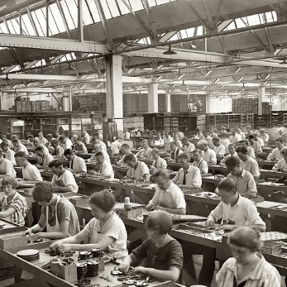

We can correct this trend
timeline: | 10,000 BC |  | 800 BC - 500 AC | 1900 AC | 2020
housing: | primitive housing, no sanitation systems |  | simple sanitation, in rural villages | industrial revolution: central sewage & water systems, heating, electricity | post-industrial cities, tighter buildings, dryer and warmer indoor air
infectious diseases: | parasites, zoonosis | 1st epidemics: small pox, measles, influenza, plague | 1st epidemics: small pox, measles, influenza, plague | 1st pandemic “Spanish flu” introduction of antibiotics & vaccines | Increasing infections, zoonotic transmis.,ABX-resistant bacteria
Manage buildings for occupant health
Infectious and other diseases
Notes:
Over more than350’000 year humans evolved parallel to the microbiome of outside world, the nature. They spent almost their whole lives in great proximity to nature.
In the last 200 to 300 years housing, lifestyle, population density and mobility changed dramatically!
Microbes could easily keep up with the changes, having a much greater adaptive capacity than human physiology.

Slide 51
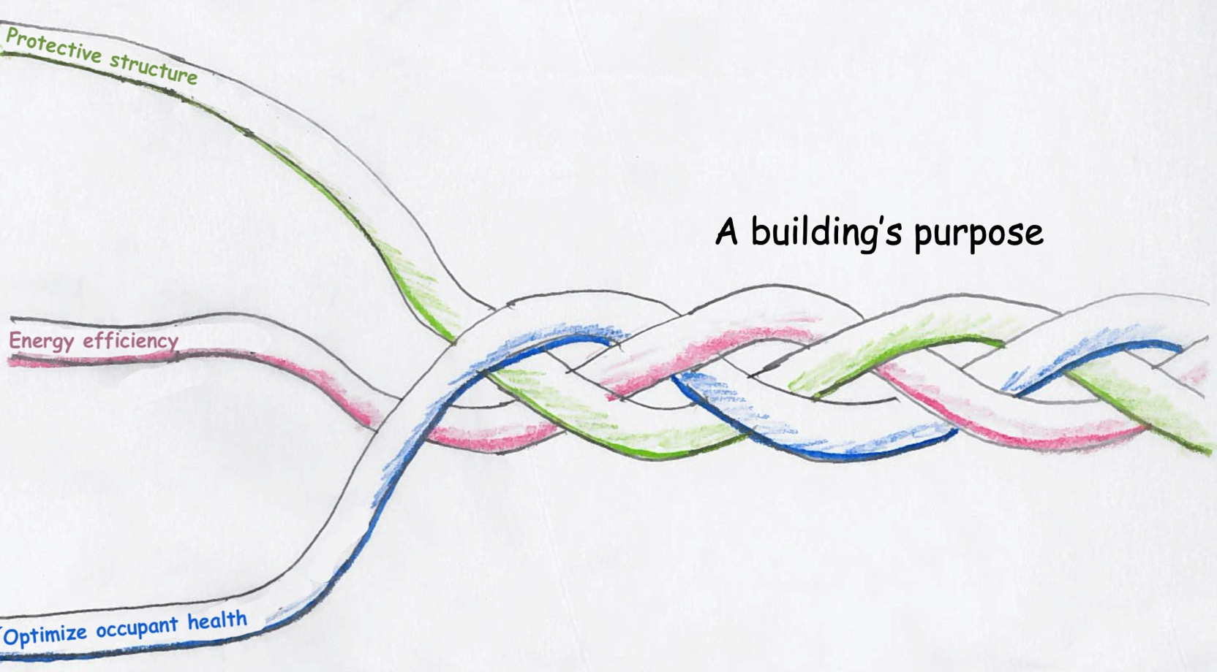
Work like you can save the the world, because we must
Past
Pre-COVID
NOW

Slide 52
Conclusions: COVID-19 is a “Wake-Up Call”
1.
Using occupant health as a lens to view the indoor environment, we have learned that IAQ is powerful.
Low relative humidity is harmful to people and benefits pathogens (bad microbes).
2.
3.
We must design and operate buildings to support occupant health, and the first step is proper indoor humidification.

Slide 53
Presentation Summary
My journey to you
Bridging divides
Homo Indooris
Studies on indoor humans and microbes
COVID and Beyond
Work like you will save the world, because you can

Slide 54

Thank you!
Stephanie Taylor, M.D., M. Arch., ASHRAE DL
Harvard Medical School, Primary Care
CEO Taylor Healthcare Consulting
e-mail: MD@taylorcx.com
phone: (860) 501-8950
and Luigi!

Slide 55
Partial Bibliography
Gibbons SM. 2016, The built environment is a microbial wasteland, mSystems 1(2):e00033-16. d
Kembel SW, 2012, Architectural design influences the diversity and structure of the built environment microbiome, The ISME Journal (2012) 6, 1469–1479
Stone W et al, 2016, Microbes at Surface-Air Interfaces: The Metabolic Harnessing of Relative Humidity, Surface Hygroscopicity, and Oligotrophy for Resilience, frontiers in Microbiology 7:1563. doi: 10.3389/fmicb.2016.01563
Ebinesh A, 2017, Conspiracy of domestic microenvironment, bacterial stress response and directed mutagenesis towards antimicrobial resistance: Lessons for health care. J Infectious Disease Med Microbiol. 2017;1(1):1-3.
Helsinki alert of biodiversity and health, Annals of Medicine, 2015
Vandegrift R et al, 2017, Cleanliness in context: reconciling hygiene with a modern microbial perspective, Microbiome (2017) 5:76
Chopra A, Lineweaver, 2016, The Case for a Gaian Bottleneck: The Biology of Habitability, ASTROBIOLOGY, Volume 16, Number 1, 2016
Goffau MC et al, 2009, Bacterial pleomorphism and competition in a relative humidity gradient, Environmental Microbiology (2009) 11(4), 809–822
Kramer A et al, 2006, How long do nosocomial pathogens persist on inanimate surfaces, a systematic review, BMC Infectious Diseases 2006, 6:130
Noti JD et al. 2013. Higher Humidity Leads to Loss of Infectious Virus from Simulated Coughs. University of Illinois.
Tropical Medicine & International Health. 2008., Volume 13, Issue 12, pages 1543-1552, 6 Oct.
Sterling EM et al. 1985. Criteria for Human Exposure to Humidity in Occupied Buildings. ASHRAE Transactions. Vol. 91. Part 1.
Fuchsman et al. 2017. Effect of the environment on horizontal gene transfer between bacteria and archaea . PeerJ 5:e3865; DOI 10.7717/peerj.3865.
Donovan TL et al. 2008. Employee absenteeism based on occupational health visits in an urban tertiary care Canadian hospital. Public Health Nursing 25(6), 565-575.

