Slide 1


Efficient HVAC/R
David Long
Cromwell Architects Engineers
Northwest Arkansas Chapter of ASHRAE
September 9, 2021

Slide 2
Thermodynamics
Why is HVAC
So Cool?
First Law of Thermo
Conservation of Energy
Second Law of Thermo
Entropy
Energy flows from Hot to Cold

Slide 3
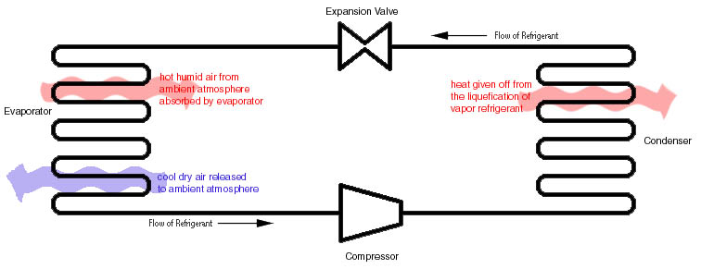
Overcoming the 2nd Law
Efficiency over 100%???

Slide 4
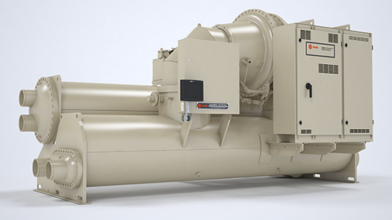

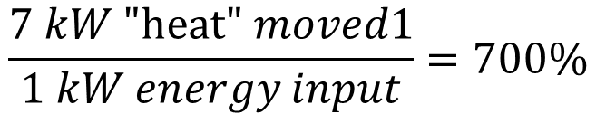


700% Efficiency
Kind of....
MOVING energy, not transforming
Said another way… a Coefficient of Performance (COP) of 7
$$1 ton\left(refrigeration\right)≈3.5 kw$$
$$@ \sim .5kw/ton$$
$$\frac{7 kW "\text{heat}\text{" }moved1}{1 kW energy input}=700\%$$

Slide 5
COP and other Ratings
Single Point of Operation “Instantaneous”
kW/Ton
EER
COP
IEER
HSPF
%
myPLV
SEER
NPLV
IPLV
SPLV
Averaged/Integrated “seasonally”

Slide 6
Progression through Ratings - Instantaneous
% desired energy out divided by energy input
(think energy turned to heat/noise by motor, or fan/pump)
Kw/Ton desired result (heat moved) – thermal energy
divided by energy in to do it (work) – usually electric input
COP Same as above, but with equal energy units
EER BTU/Watt
HSPF Heat Pumps – BTU/Watt in heating mode + heat strip energy if required

Slide 7
Progression through Ratings - Seasonal
IPLV COP values - weighted average at four
ambient conditions & equipment loads per AHRI
NPLV Similar to IPLV but non-AHRI prescribed condenser water temp
SPLV/myPLV Proprietary ratings (manufacturer created) similar to IPLV/NPLV but with project specific weightings

Slide 8
Progression through Ratings - Seasonal
IEER EER values - weighted average at four
ambient conditions & equipment loads per AHRI
SEER IEER but for residential style equipment

Slide 9
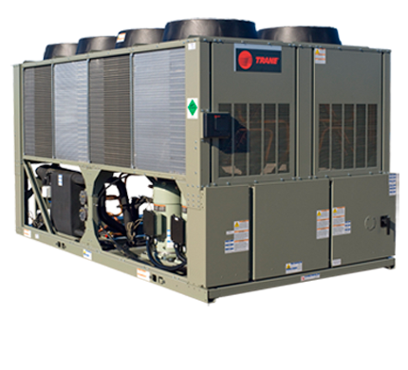
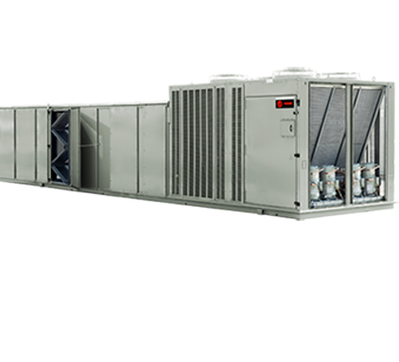
A Thought on EER
Air Cooled Chiller
Packaged DX Unit
Same Manufacturer
Same Compressors
Same Condenser Fans
Same Condenser Coils
Same Capacity
EER
EER
Which Is True?
Remember: EER IS
INDIVIDUAL EQUIPMENT ONLY
NOT SYSTEM EFFICIENCY
“indoor” fan energy included because it’s part of the equipment
EER
EER
EER
EER

Slide 10

A final thought on Performance Metrics

Slide 11
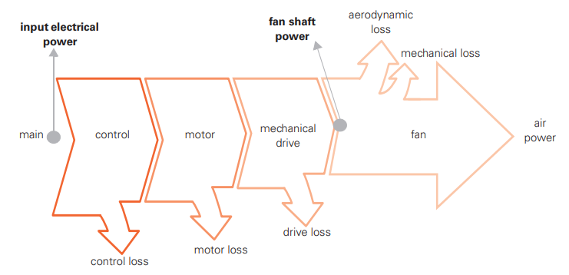
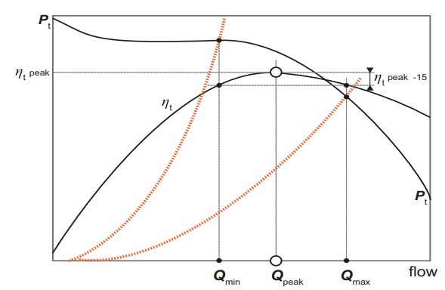
On Pump and Fan Efficiencies
Several Factors
  Selections
  Losses
Moving Heat
  Water “Pumps” better
  Water holds more heat

Slide 12
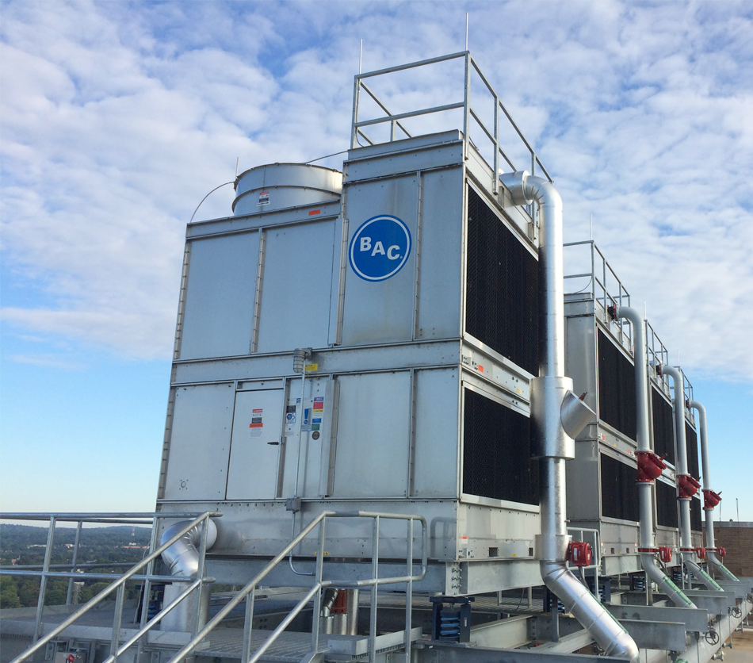
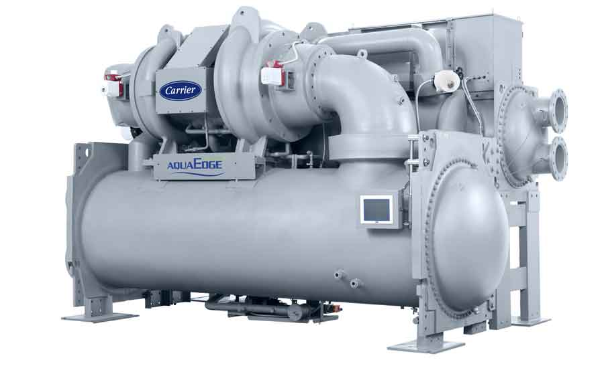
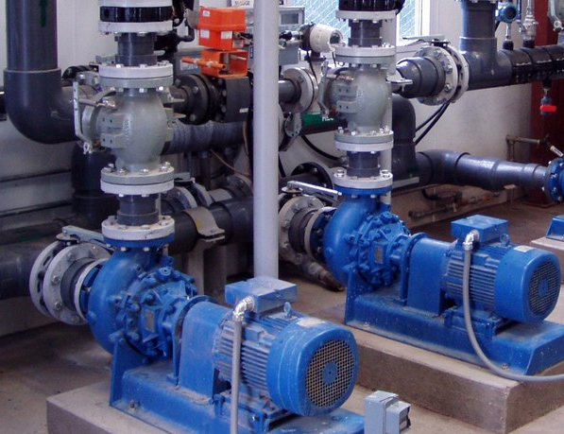
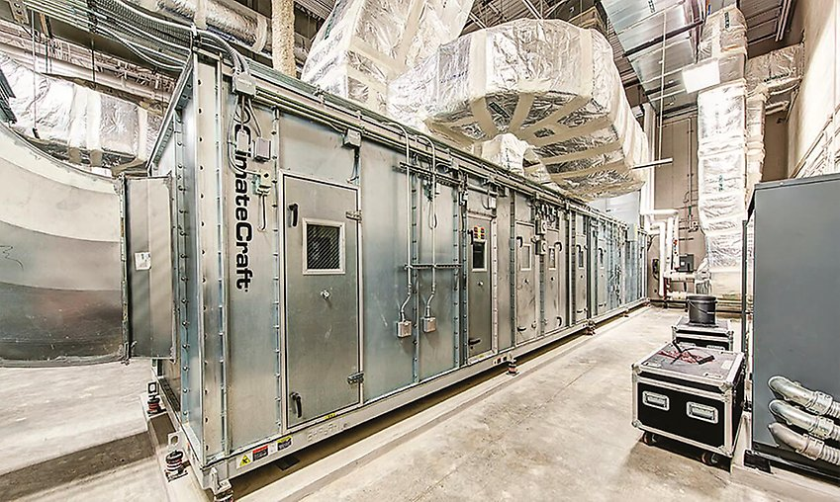
HVAC System Component Efficiencies
Condenser Water System
Pumps (70%-90%)
Fans (50% - 70%)
Water Loss (Evaporation)
Chiller
COP (700%)
CHW Distribution
Pumps (70-90%)
Zone Distribution
Fans (50-70%)
1
2
3

Slide 13
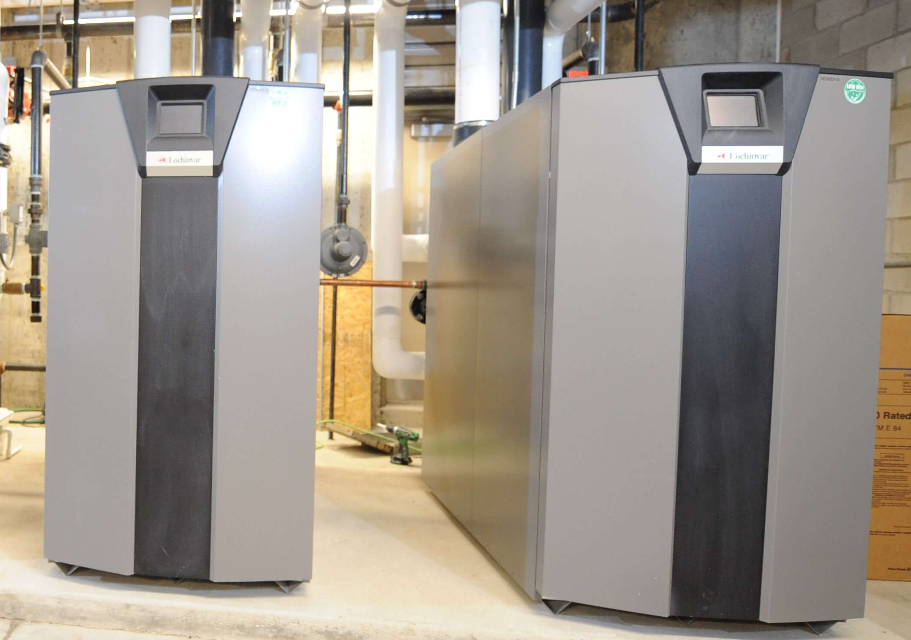
What About Heating?
Condenser Water System
Pumps (70%-90%)
Fans (50% - 70%)
Water Loss (Evaporation)
Boilers
Electric ~ 100%
Gas >95% (condensing)
+ Gas is cheaper (for now)
Chiller
COP (700%)
CHW Distribution
Pumps (70-90%)
CHW Distribution
Fans (50-70%)
1
2
3

Slide 14


Slide 15
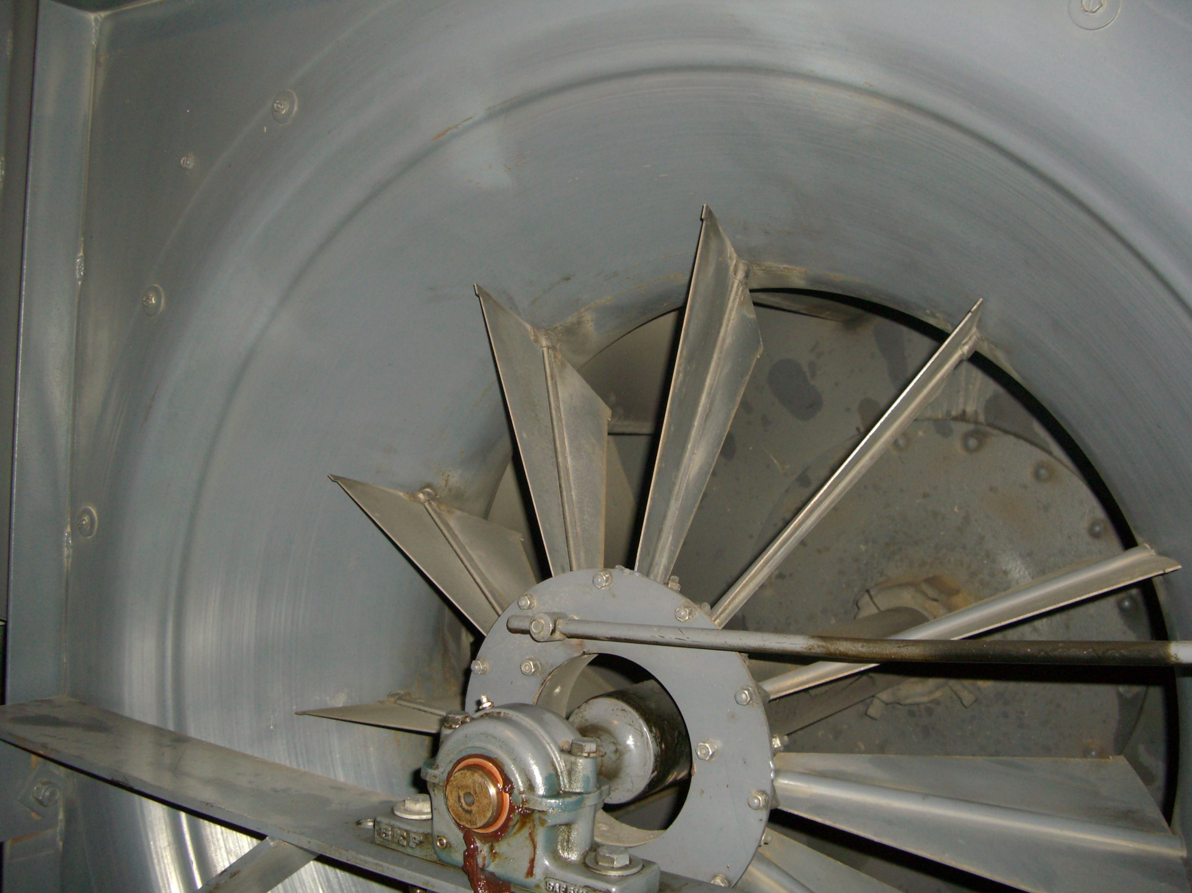
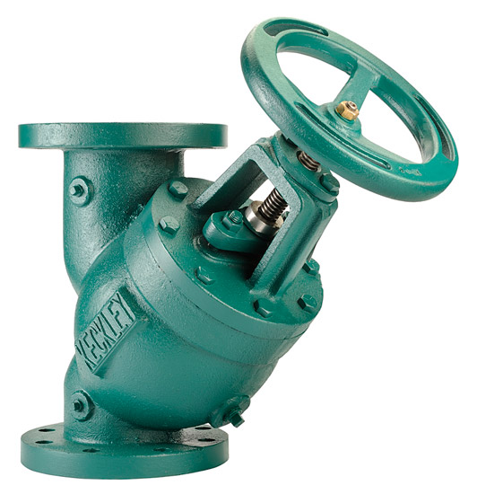
VFDs
VFDs have losses!
Simply replacing a motor starter with a VFD does NOT increase efficiency
Some “traditional” balancing means introduce physical losses
  Inlet Guide Vanes
  Triple Duty Valves
When retrofitting to VFDs
  OPEN or remove balancing device
When designing new water system with VFDs
  DON’T USE A TRIPLE DUTY VALVE

Slide 16
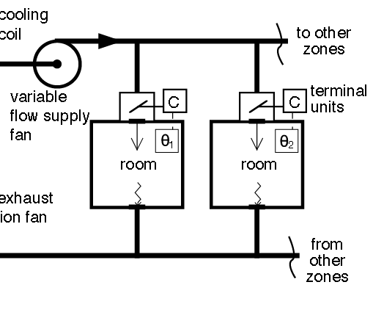
VAV System - Resets
“Critical Zone Reset”
“Trim and Respond”
“Optimized VAV”
When Zones are satisfied, system capacity can be reduced.
Capacity can be reduced by:
  a.) Reducing Airflow
  b.) Increasing Supply Air Temperature (cool it less, don’t reheat)

Slide 17
VAV System - Resets
VAV boxes vary cooling capacity by using a damper to reduce airflow
System Wide: What about when all zones require less than full airflow?
  Indicated by VAV dampers all being somewhat closed*
Reduce System Capacity! Airside or Waterside/Refrigerant?
Airside: Reduce pressure (VAVs already reduced volume)
Waterside/Refrigerant: Increase AHU Supply Air Temp
(decrease chilled water or DX demand from AHU)

Slide 18
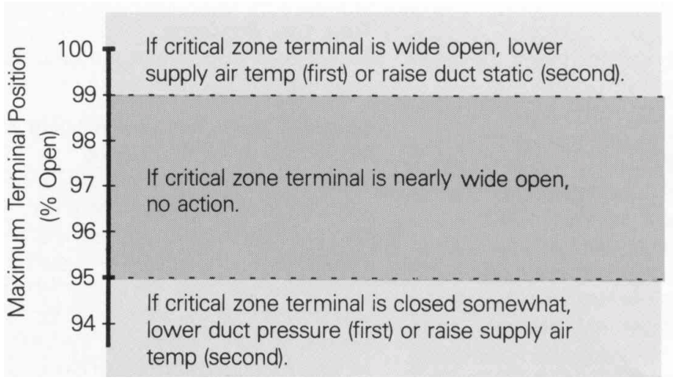
VAV System - Resets
Remember order of efficiency.
  Reduce Airside first
Reset Duct Static Pressure Setpoint
  Fan Slows Down
  VAVs Open to maintain airflow -> Decreases Induced Losses
  Continuous Reset based on Most open VAV
Another Benefit: Maintains humidity control due to steady coil temp
  Only reset discharge air temp (waterside reduction) after fan is at minimum speed, and always monitor humidity when increasing DAT.

Slide 19
VAV System - Resets
Remember order of efficiency.
  Reduce Airside first, then further reduce waterside/refrigerant load
Reset Discharge Air Temperature
  Control valve likely already backed off due to decrease air volume
  Increase discharge air temperature setpoint
  Control valve closes off even more, reducing heat rejected to water.
  Continuous Reset based on zone cooling demand, and:
Remember as supply air temperature rises, inherit humidity control is reduced – so watch space or return air humidity!

Slide 20
Variable Speed Pumping Resets
Similar to VAV Critical Zone
“Critical Valve Reset”
When Units/coils are satisfied, system capacity can be reduced.
Capacity can be reduced by:
  a.) Reducing waterflow
  b.) Increasing Supply Water Temperature (chilled water)

Slide 21
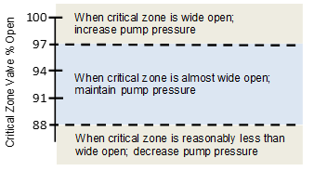
Variable Pumping System - Resets
Control Valves vary capacity of a coil by reducing waterflow via increased pressure drop
System Wide: What about when all coils require less than design water flow?
  Indicated by all control valves being somewhat closed*
Reduce System Capacity! Pumping or Chiller Energy?
  Pumping: Reduce system differential pressure
  (control valves already reduced volume)
  Chiller: Increase supply water temperature

Slide 22
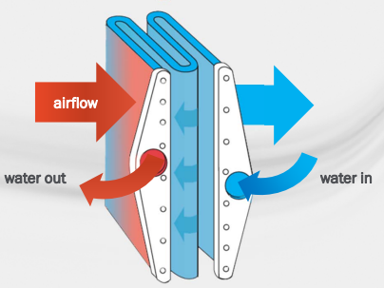
Variable Pumping System- Resets
Remember order of efficiency.
  Reduce Pumping first – Chiller is more efficient than pumps.
Reset Water Differential Pressure Setpoint
  Pump slows Down
  Control Valves Open to maintain water flow -> Decreases Induced Losses
  Continuous Reset based on most open valve
Increase Water Temperature
  Only after pumps are at minimum speed
  Be Careful: Warm coils mean no humidity control

Slide 23
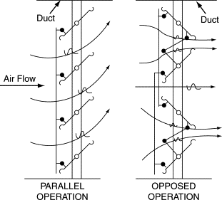
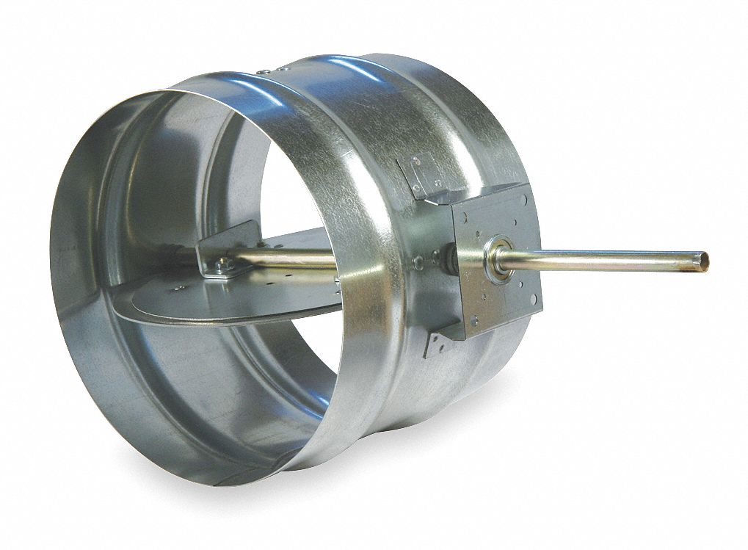
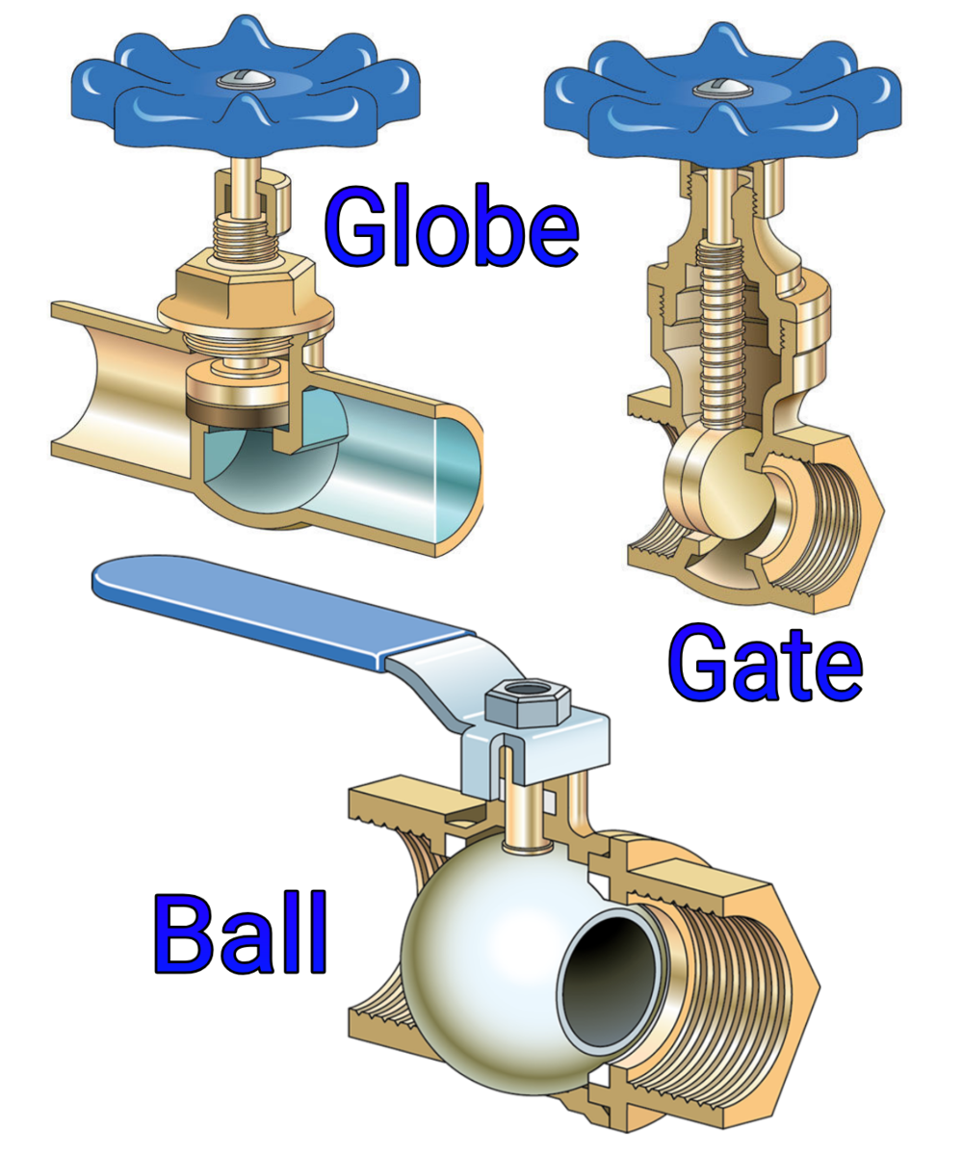
What does Open Mean?
Dampers?
Control Valves?
Percent Open
Degree Shaft Rotation
Dampers: Round? Rectangular? Opposed or Parallel?

Slide 24
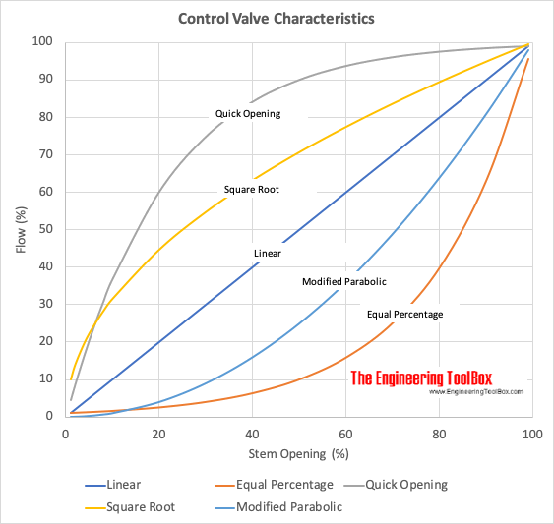
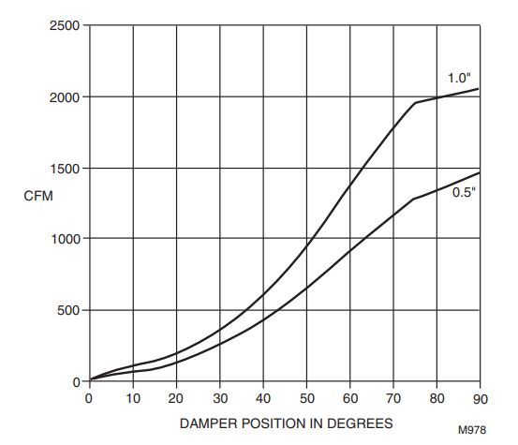
Control Characteristics
Sample Round Damper Characteristics

Slide 25
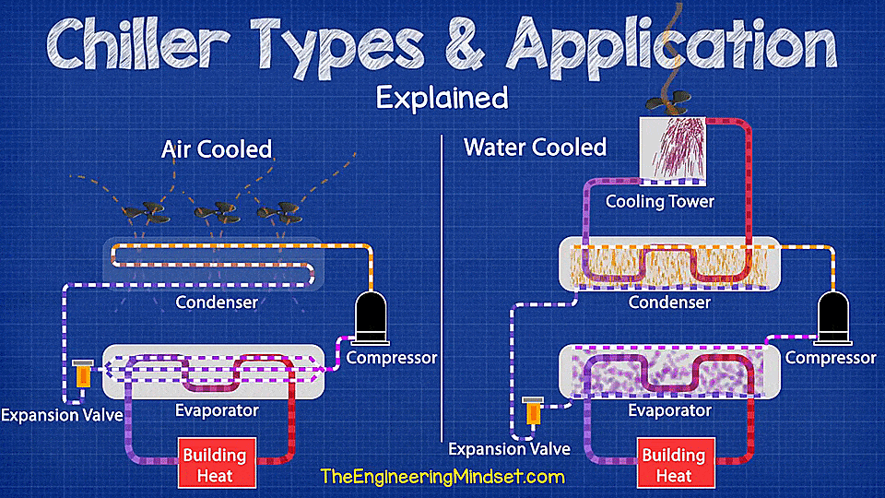
Chilled Water Systems – The rest of the Equation

Slide 26
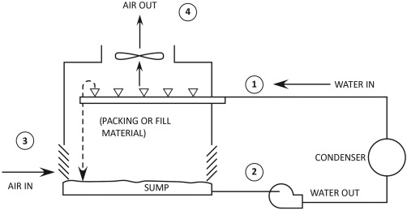
Condenser Water
Get heat out of the system.
  Still: Flow & Temp = Capacity.
  Now Wet Bulb Matters
  Chillers are still efficient
Load vs Lift
Load = Capacity (Tons)
Lift = How hard to produce load
(Condenser vs Evap Temps)

Slide 28
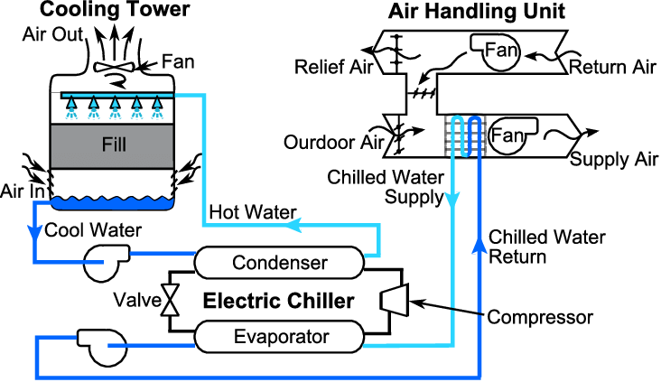
VFD
VFD
VFD
VFD

Slide 29

All Variable Speed Plant
Several Proprietary Control Schemes - “Black Boxes”
Maintenance/Service – How & What?
Operator Comfort w/ System
Very (most) Efficient
Also consider Evaporator Side

Slide 30
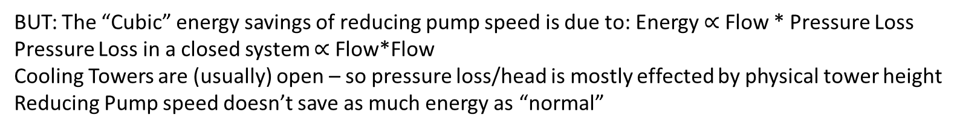
Let’s Tackle Logically –
Simple and Almost as Good
Order of Efficiency
Chiller
Pump
Fan
BUT: If condenser water is cold enough, can run in “Free Cooling Mode” (or use a free cooling HX)
BUT: The “Cubic” energy savings of reducing pump speed is due to: Energy $∝$ Flow * Pressure Loss
Pressure Loss in a closed system $∝$ Flow*Flow
Cooling Towers are (usually) open – so pressure loss/head is mostly effected by physical tower height
Reducing Pump speed doesn’t save as much energy as “normal”
BUT: Towers can also use natural convective cooling

Slide 31
A simple Approach
Assumptions:
  “Regular” operating conditions – free cooling not available
  Not using “Screw” chiller – which really love cold condenser water
  Remove Evaporator Side from the equation – set it and forget it
  Chiller is mostly going to control itself – so let’s not worry about compressor control.

Slide 32
A simple Approach – Pump/Tower
There is some absolute minimum water flow for a chiller
  Based on turbulent vs laminar flow through the condenser bundle
  Chillers can usually run at this minimum flow at full capacity – the leaving condenser water is just very HOT
  Select a tower based on these flow/temperature conditions
    (Remember ASHRAE 90.1 requires 50% turndown though)
  Pump Flow is ALWAYS at a minimum.

Slide 33
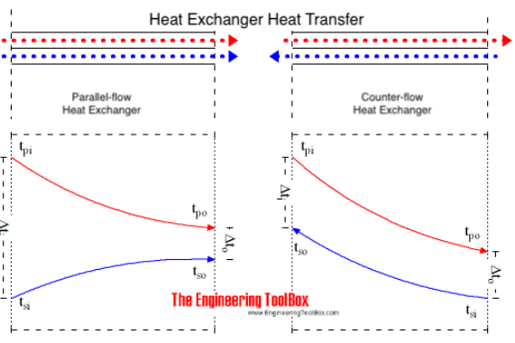
Tower Operation
Towers cool water by evaporative cooling – Wet Bulb Matters
Natural Convection accomplishes this
Forced Convection (Fans) help by increasing LMTD
Control tower fan to keep basin temp
(condenser water to chiller) at a value
based on offset from Wet Bulb Temp
  Keeps fan away from 100% operation
  Takes advantage of high LMTD
  Allows Natural Convection to work when
  possible
  Offset depends on chiller & tower performance
  … but WB + 5 deg. F is the right ballpark usually

Slide 34
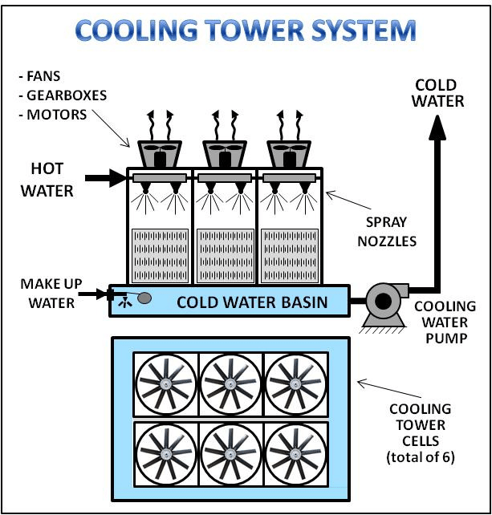
Multiple Chillers/Towers
How to handle multiple towers
or tower cells?
Consider how towers work
  Evaporative Cooling
  Maximize Surface Area
  Run as many “cells” as you can at
  given condenser flow

Slide 35
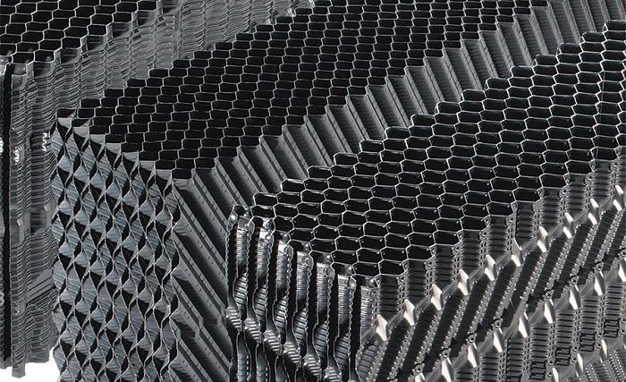
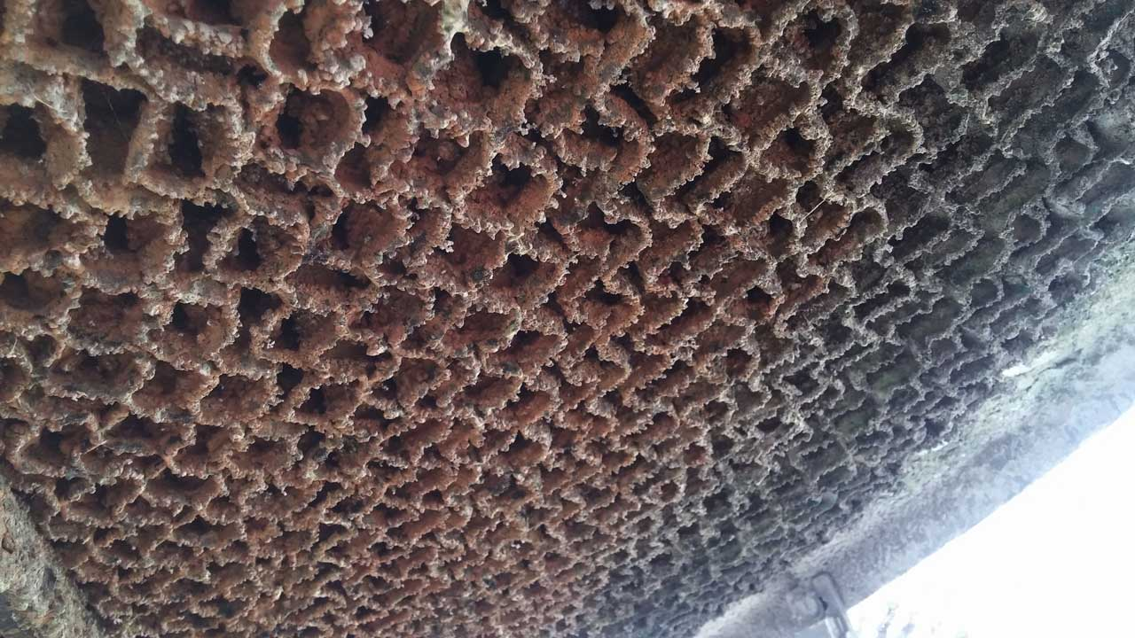
Cooling Tower Min Flow

Slide 36
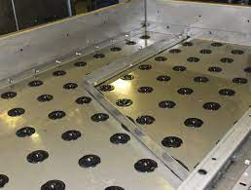
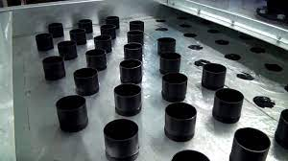

Slide 37
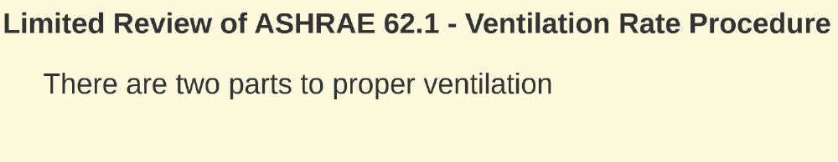


Changing Gears – One Last Topic
Demand Controlled Ventilation

Slide 38
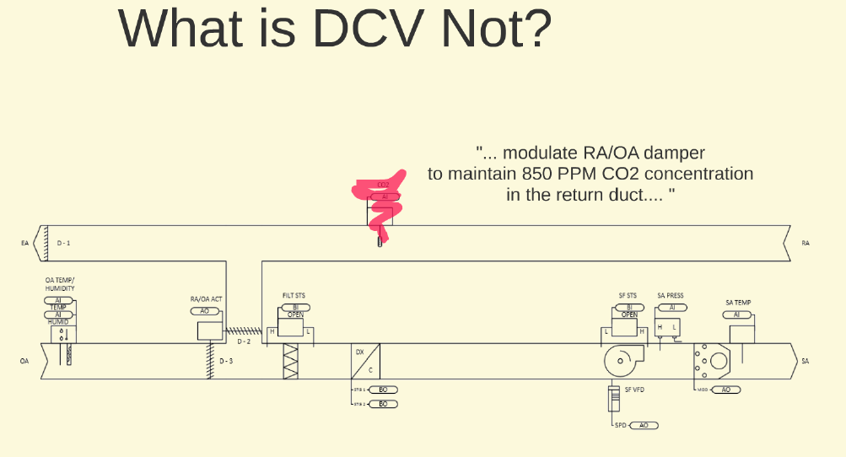
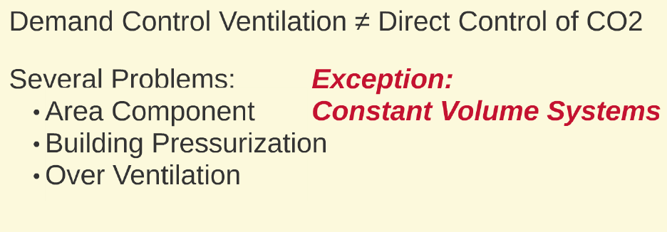

Slide 39
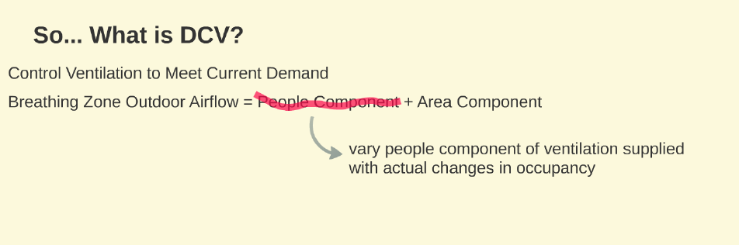

Slide 40
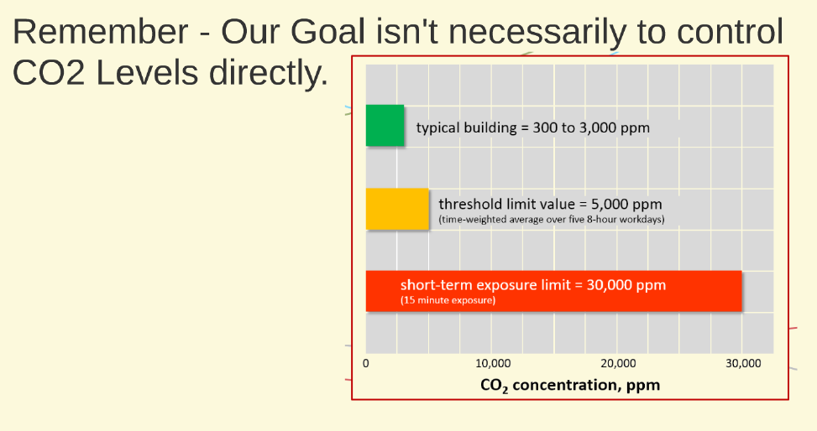
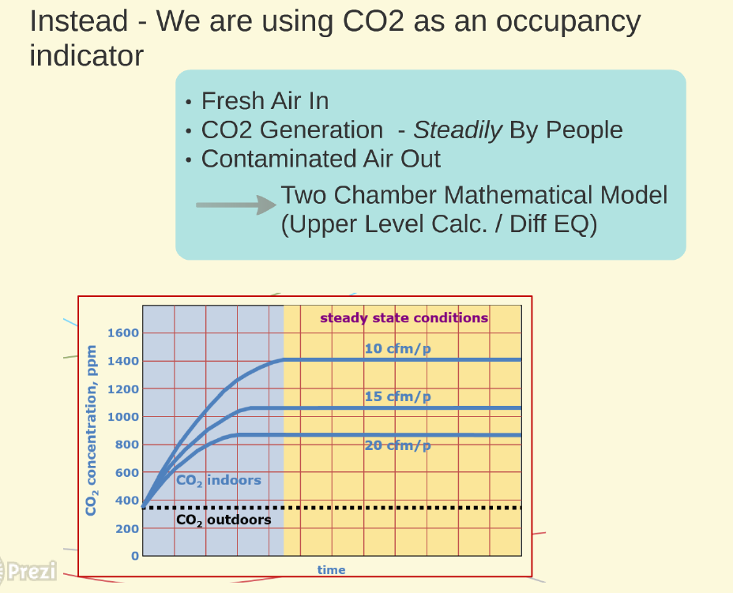

Slide 41
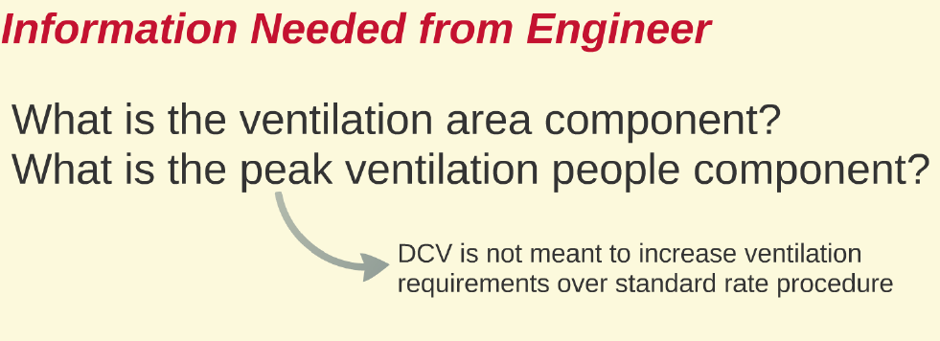

Slide 42
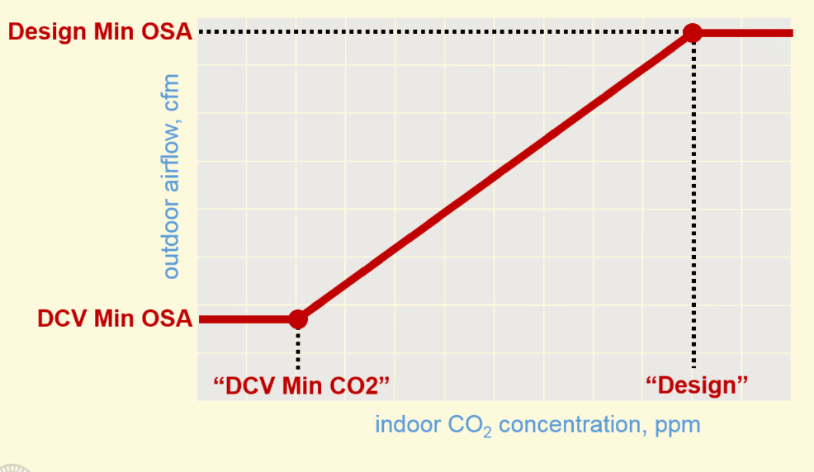

Slide 43
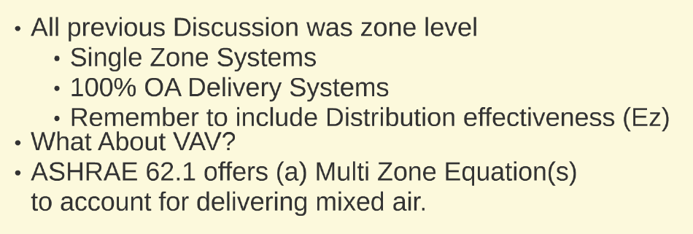

Slide 44
