Slide 1
Electric Motor to VFD Compatibility
Jack Bailey
Yaskawa America, Inc

Slide 2
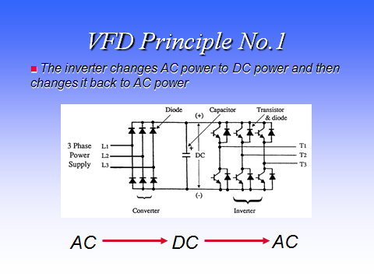

Slide 3
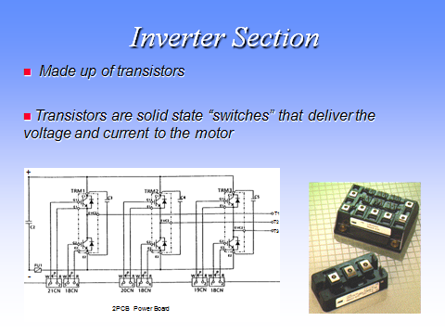

Slide 4
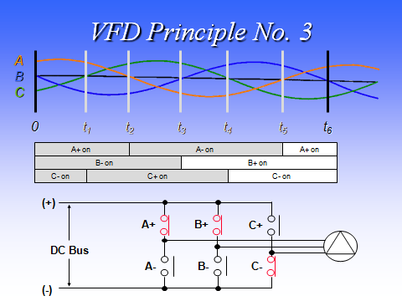

Slide 5
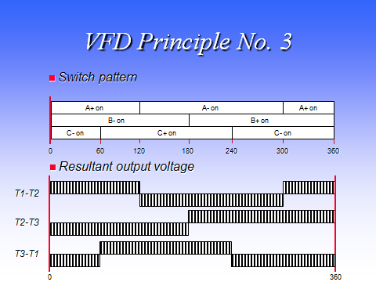

Slide 6
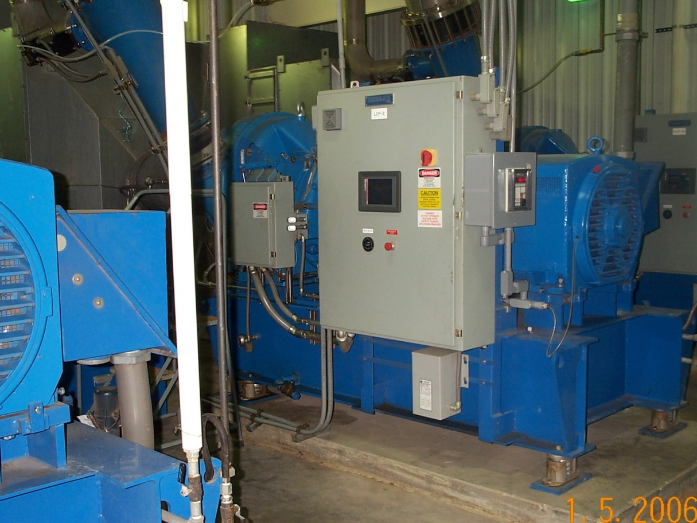
Motor and VFD Compatible
NEMA MG 1 Part 31, MG1 Part 30, Inverter rated, Good insulation systems

Slide 7
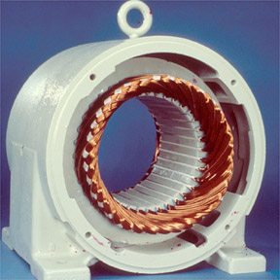
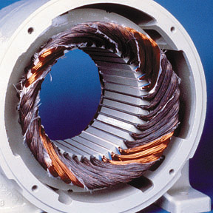
Single Phased Motor
Before
After

Slide 8
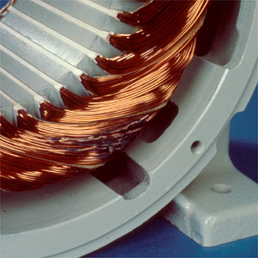
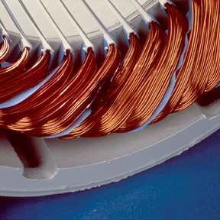
Turn to Turn Short
Before
After

Slide 9
Shorted Phase to Phase
Before
After

Slide 10
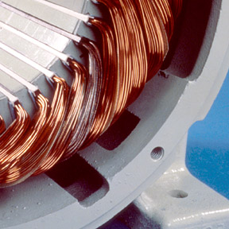
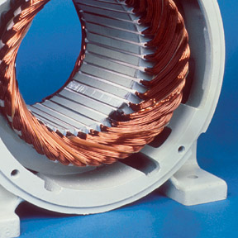
Shorted Coil

Slide 11
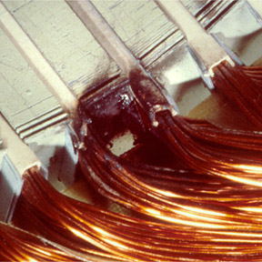
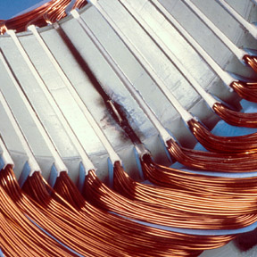
Shorted in Slot

Slide 12
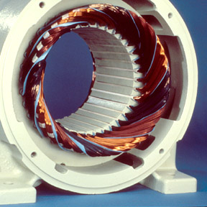
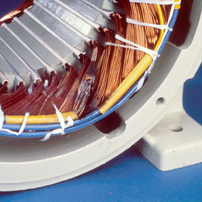
Unbalanced Voltage and Voltage Surge

Slide 13
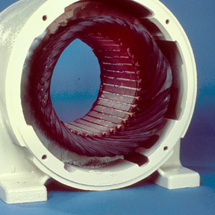
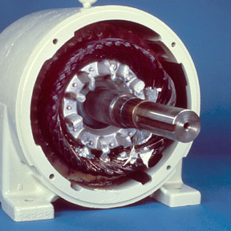
Motor Overload and Locked Rotor

Slide 14
VFD Generated Motor Issues
Overshoot Voltage
Reflected Wave and Standing Wave
Low Rise Time
Long Leads
Non Inverter Tolerant Motors
Bearing Failures

Slide 15
Solutions
NEMA MG 1 Part 31 (30), OEM Packaged and approved
Load Reactors
DV/DT Filters
Sign Wave Filters
3 Level Inverters

Slide 16
Higher Risk Motors
Submersible Pump Motors
Small 460V Definite Purpose
Some Imports
Old Small Motors

Slide 17
What is your drive trying to tell you
GFI Tripping
Sporadic OV, UV or other trips including OL2 and OC.
Short circuit trip

